Slide 1
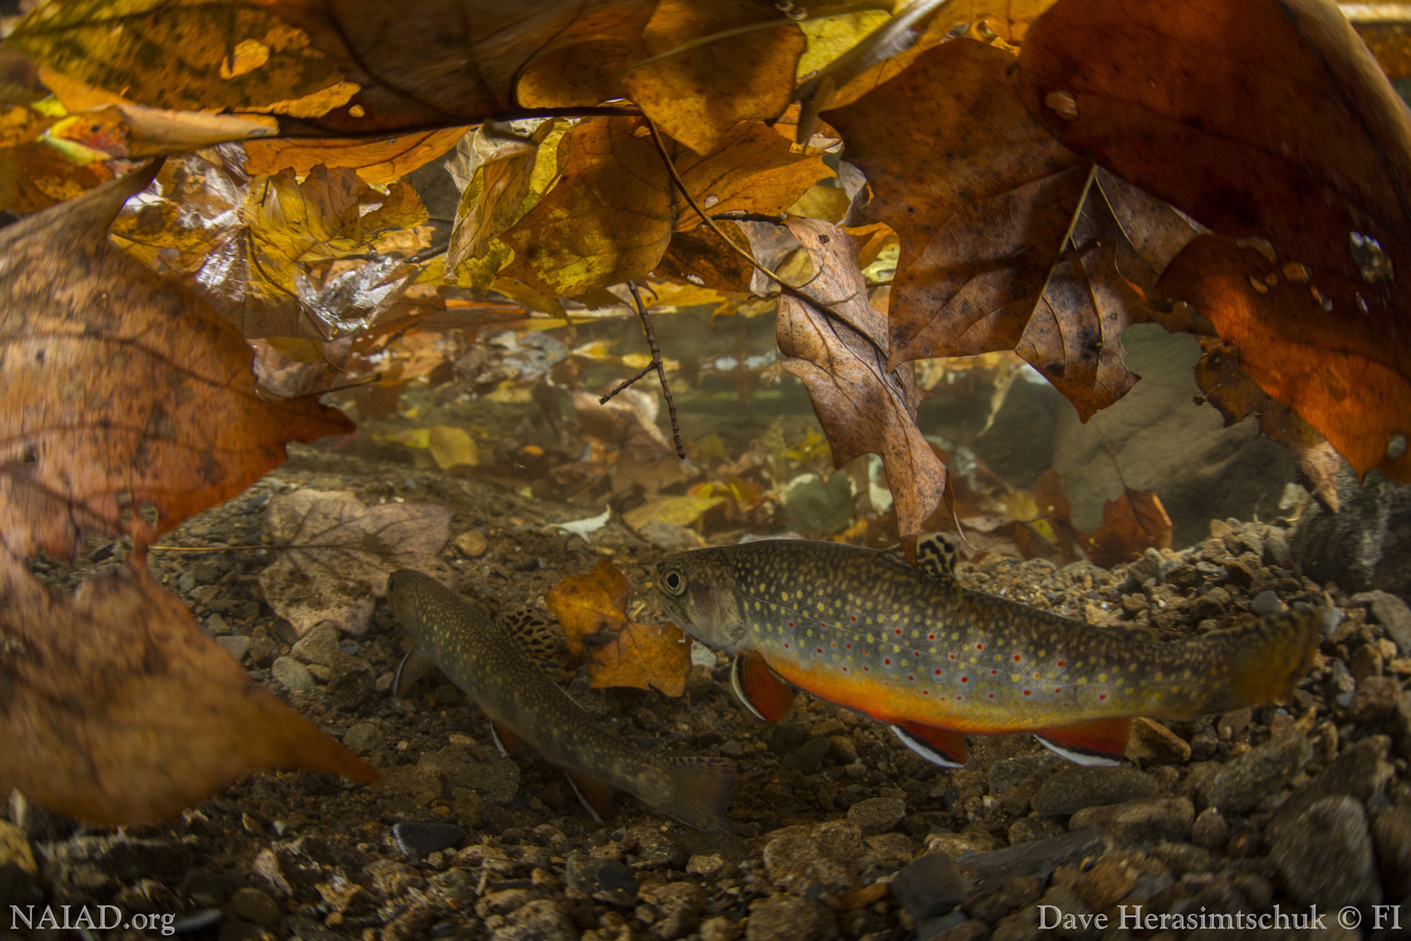
Responses of individual size distributions across a continental gradient of temperature and resource supply
Jeff Wesner¹, Vojsava Gjoni¹, Justin Pomeranz² , Jim Junker³
¹ University of South Dakota, Department of Biology, Vermillion, SD 57069 ² Colorado Mesa University, Environmental Science and Technology, Grand Junction, CO 81501 ³ Great Lakes Research Center, Michigan Technological University, Houghton, MI 49931 ⁴ Louisiana Universities Marine Consortium, Chauvin, LA 70344
Notes:
Thank you to Savina and Jim for organizing….

Slide 2
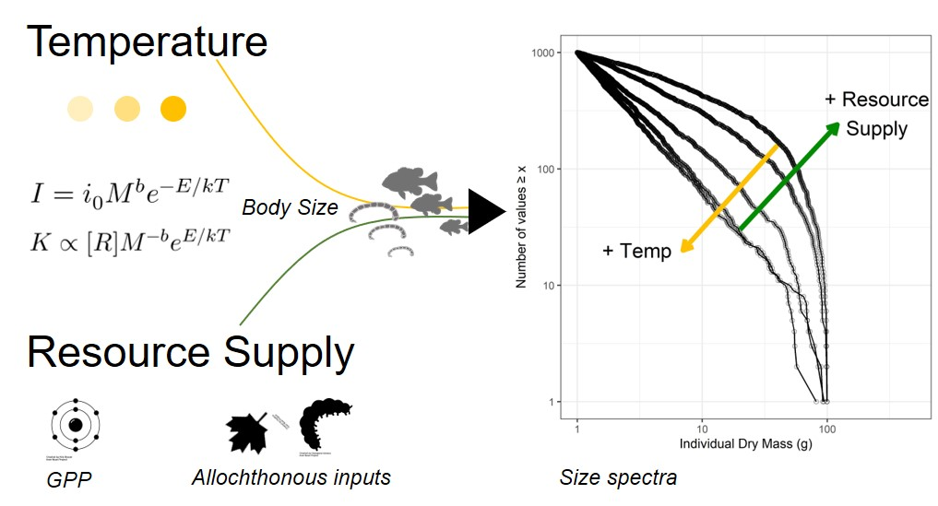
Junker, J. R., Cross, W. F., Benstead, J. P., Huryn, A. D., Hood, J. M., Nelson, D., ... & Ólafsson, J. S. (2020). R esource supply governs the apparent temperature dependence of animal production in stream ecosystems. Ecology Letters, 23(12), 1809-1819.
Cross, W. F., Hood, J. M., Benstead, J. P., Huryn, A. D., & Nelson, D. (2015). Interactions between temperature and nutrients across levels of ecological organization. Global Change Biology, 21(3), 1025-1040.
Notes:
Temperature and resource supply are two fundamental drivers ecological cycling and process rates in ecosystems. They are fundamental to metabolic scaling theory and are thought to alter the structure and functioning of ecosystems, in part, by limiting the size of organisms that can exist in food webs.

Slide 3
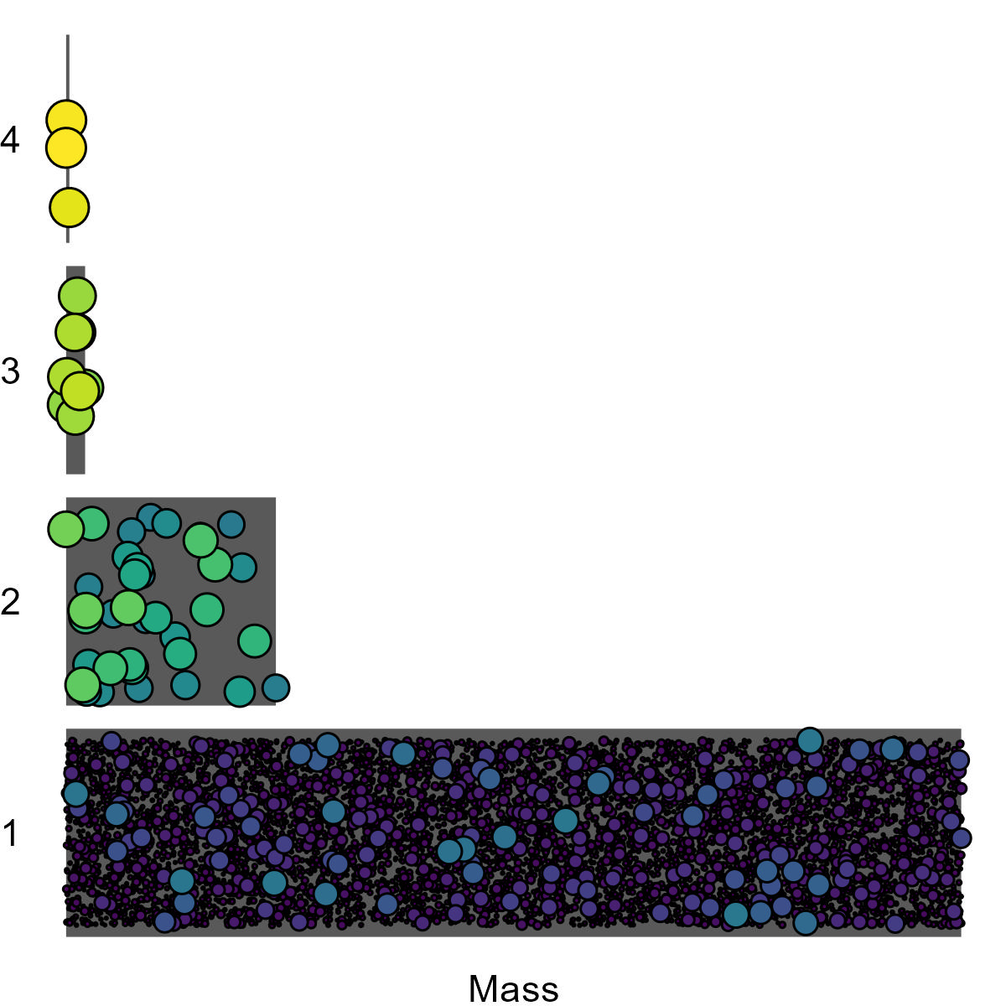


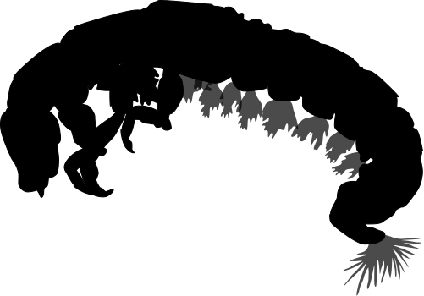



Junker, J. R., Cross, W. F., Benstead, J. P., Huryn, A. D., Hood, J. M., Nelson, D., ... & Ólafsson, J. S. (2020). R esource supply governs the apparent temperature dependence of animal production in stream ecosystems. Ecology Letters, 23(12), 1809-1819.
Cross, W. F., Hood, J. M., Benstead, J. P., Huryn, A. D., & Nelson, D. (2015). Interactions between temperature and nutrients across levels of ecological organization. Global Change Biology, 21(3), 1025-1040.
Notes:
This is especially important in size structured food webs, like aquatic ecosystems, in which predators feed on smaller and smaller prey.

Slide 4
Size Spectra: frequency of individual body sizes within a community
N ~ M^{λ}
Abundance
Individual Body Size
Trebilco et al. 2013. TREE.
Notes:
In particular, these food webs can be represented by ecological size spectra shown here, in which…

Slide 5
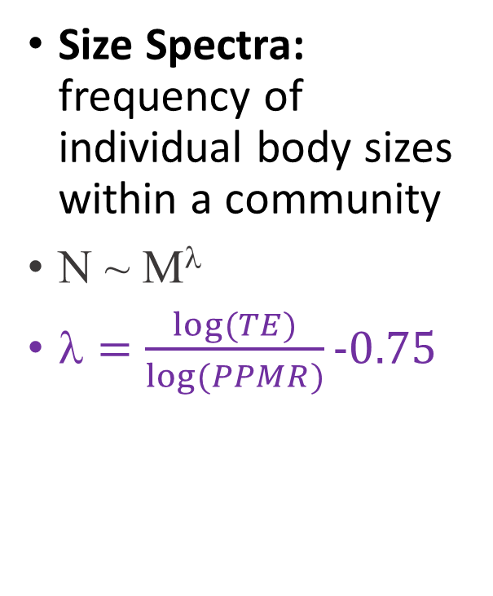
Size Spectra: frequency of individual body sizes within a community
N ~ M^{λ}
λ $=\frac{log⁡(TE)}{log⁡(PPMR)}−0.75$
λ
Abundance
Individual Body Size
Trebilco et al. 2013. TREE.
Brown 2004. Ecology
Notes:
In particular, these food webs can be represented by ecological size spectra shown here, in which…

Slide 6
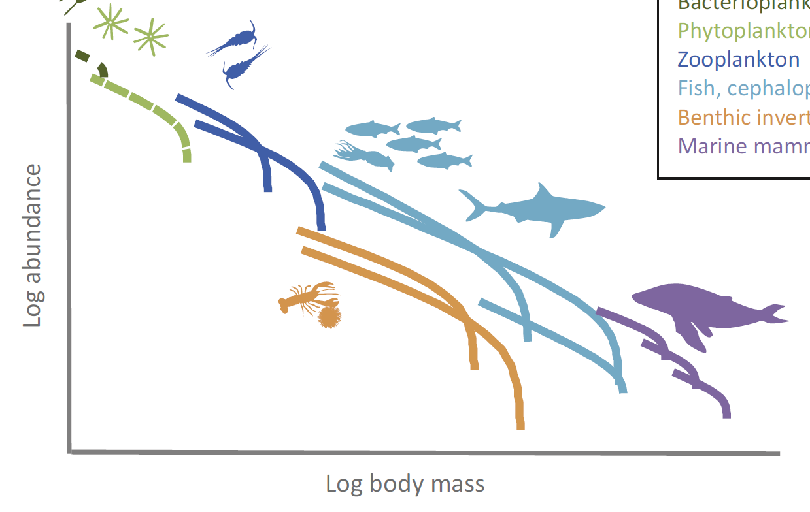
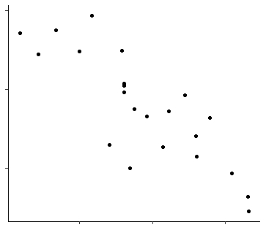
Relatively fewer large organisms at high temperatures
Size Spectra: frequency of individual body sizes within a community
N ~ M^{λ}
“Shallower” slopes
Log abundance
λ (slope of size spectrum)
λ
“Steeper” slopes
Temperature
Log body mass
Temperature
Brown, J. H., Gillooly, J. F., Allen, A. P., Savage, V. M., & West, G. B. (2004). Ecology, 85(7), 1771-1789.
Blanchard, J. L., Heneghan, R. F., Everett, J. D., Trebilco, R., & Richardson, A. J. (2017). TREE, 32(3), 174-186.
Saito, V. S., Perkins, D. M., & Kratina, P. (2021). TREE, 36(4), 280-283.

Slide 7
Theory is clear (sort of). Empirical patterns are not.
Size Spectra: frequency of individual body sizes within a community
N ~ M^{λ}
Temperature x Resource Supply?
Resource supply?
λ
Temperature
Mazurkiewicz et al. 2020
McGarvey and Kirk 2018
O’Gorman et al. 2017
λ (slope of size spectrum)
Yvon-Durocher et al. 2011
Dossena et al. 2012
Pomeranz et al. 2022
Temperature
Brown, J. H., Gillooly, J. F., Allen, A. P., Savage, V. M., & West, G. B. (2004). Ecology, 85(7), 1771-1789.
Blanchard, J. L., Heneghan, R. F., Everett, J. D., Trebilco, R., & Richardson, A. J. (2017). TREE, 32(3), 174-186.
Saito, V. S., Perkins, D. M., & Kratina, P. (2021). Trends in Ecology & Evolution, 36(4), 280-283.

Slide 8
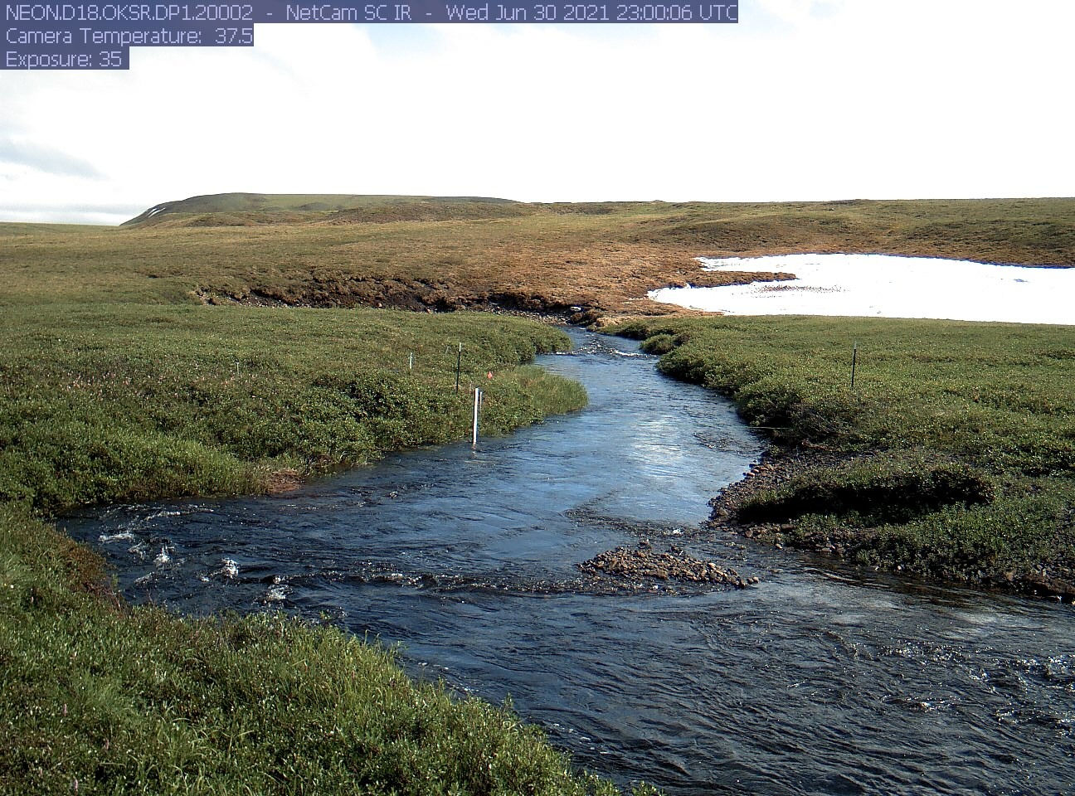
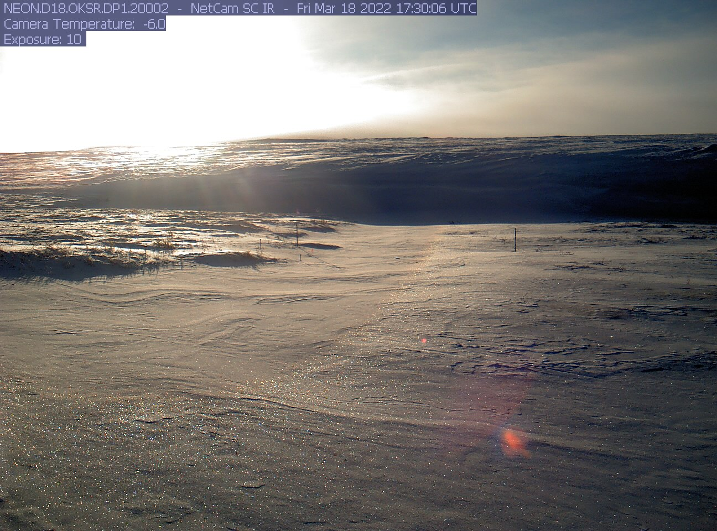
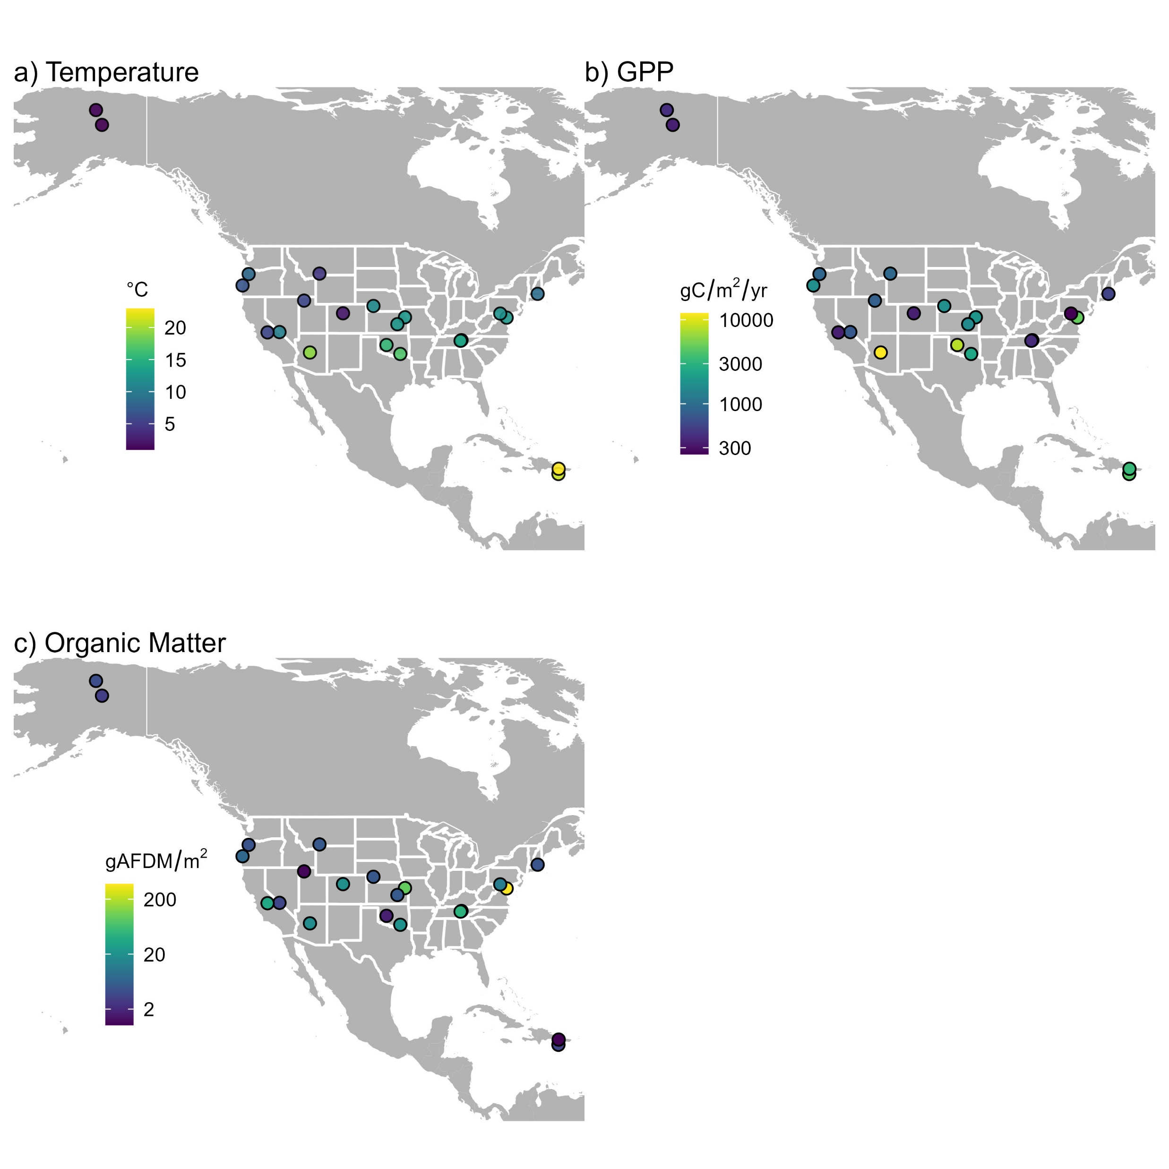
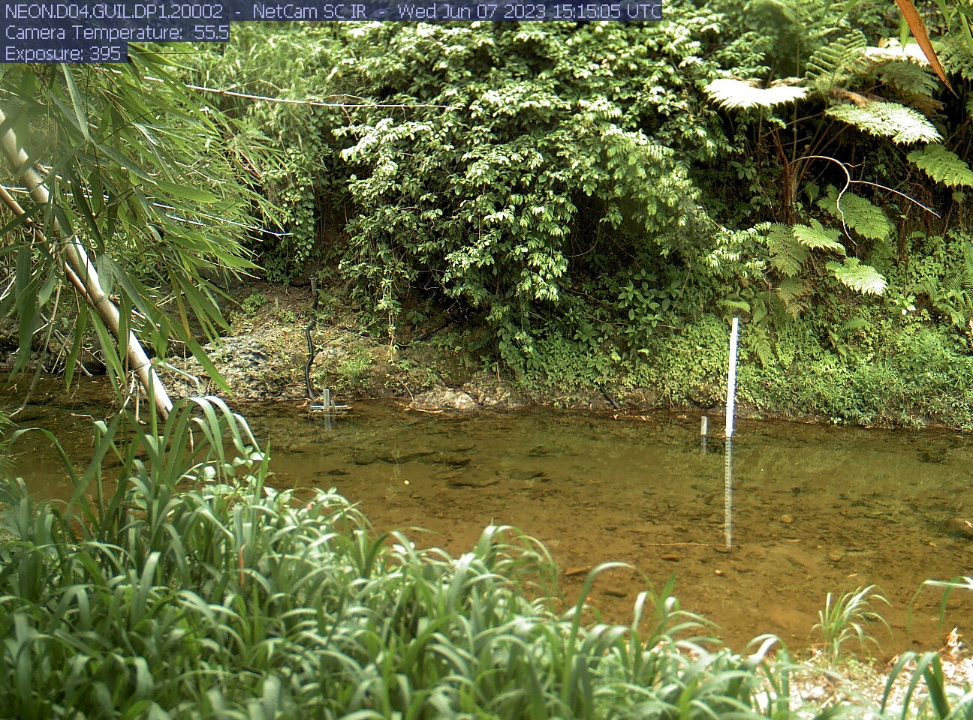
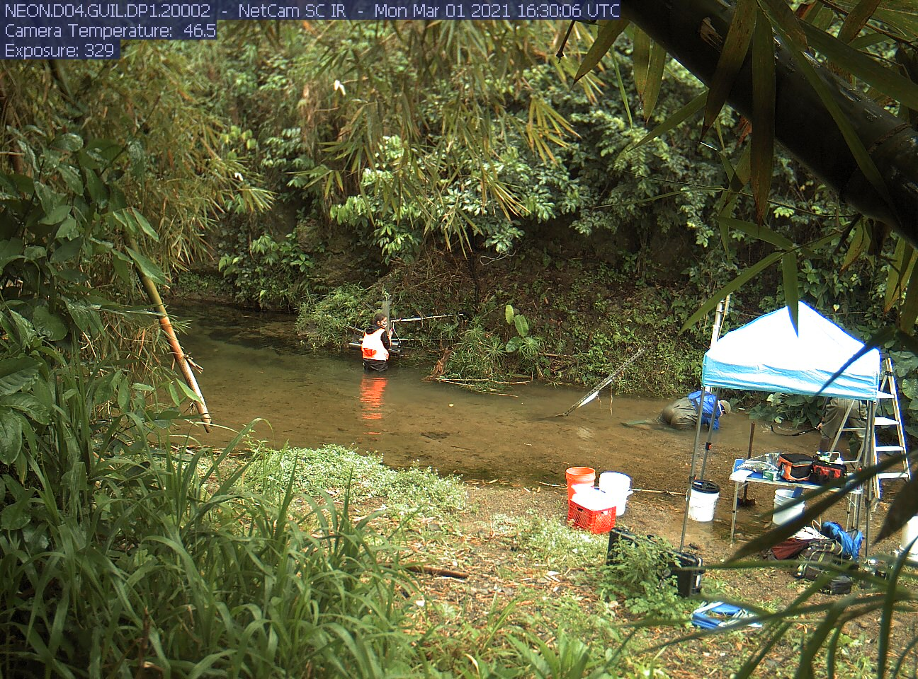
Alaska
Puerto Rico
OKSR - June
OKSR - March
GUIL - June
GUIL - March

Slide 9
National Ecological Observatory Network (NEON)
Temperature
1 to 23°C (mean annual water temp)
Resource Supply
250 to 12,000 GPP (gC/m²/y)
1 to 370 Allochthonous (gAFDM/m²)

Slide 10

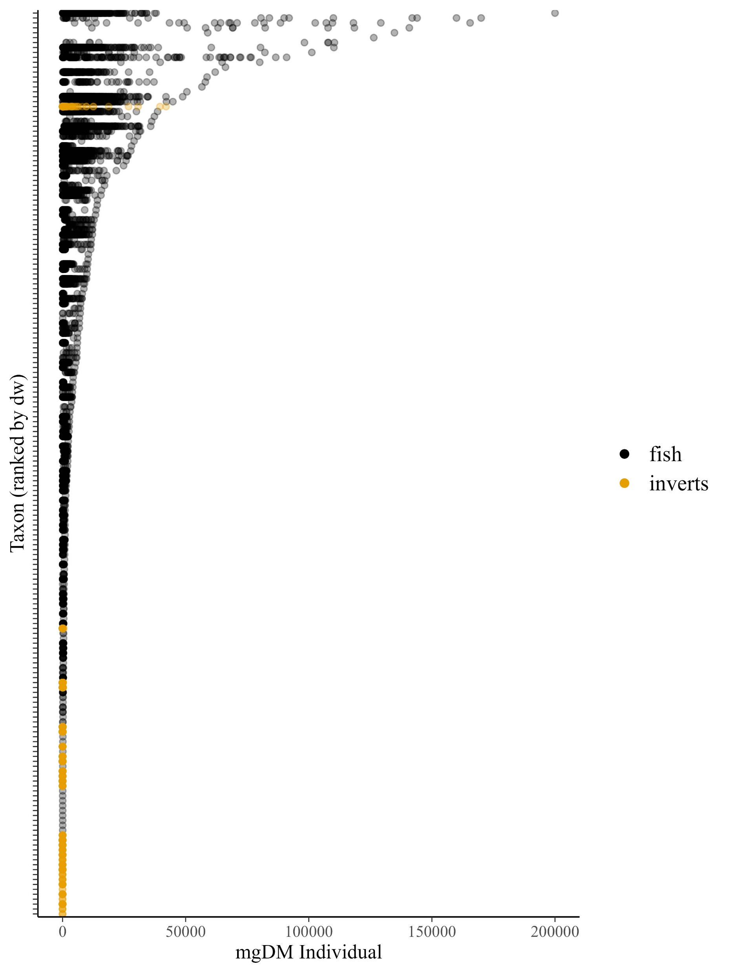






2,468,683 individual sizes
1,155 invertebrate species
157 fish species
132 collections
23 freshwater streams
9 orders of magnitude (size)
5 years
Notes:
Introduce neon data

Slide 11
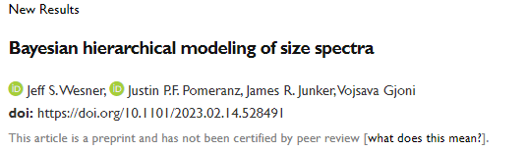
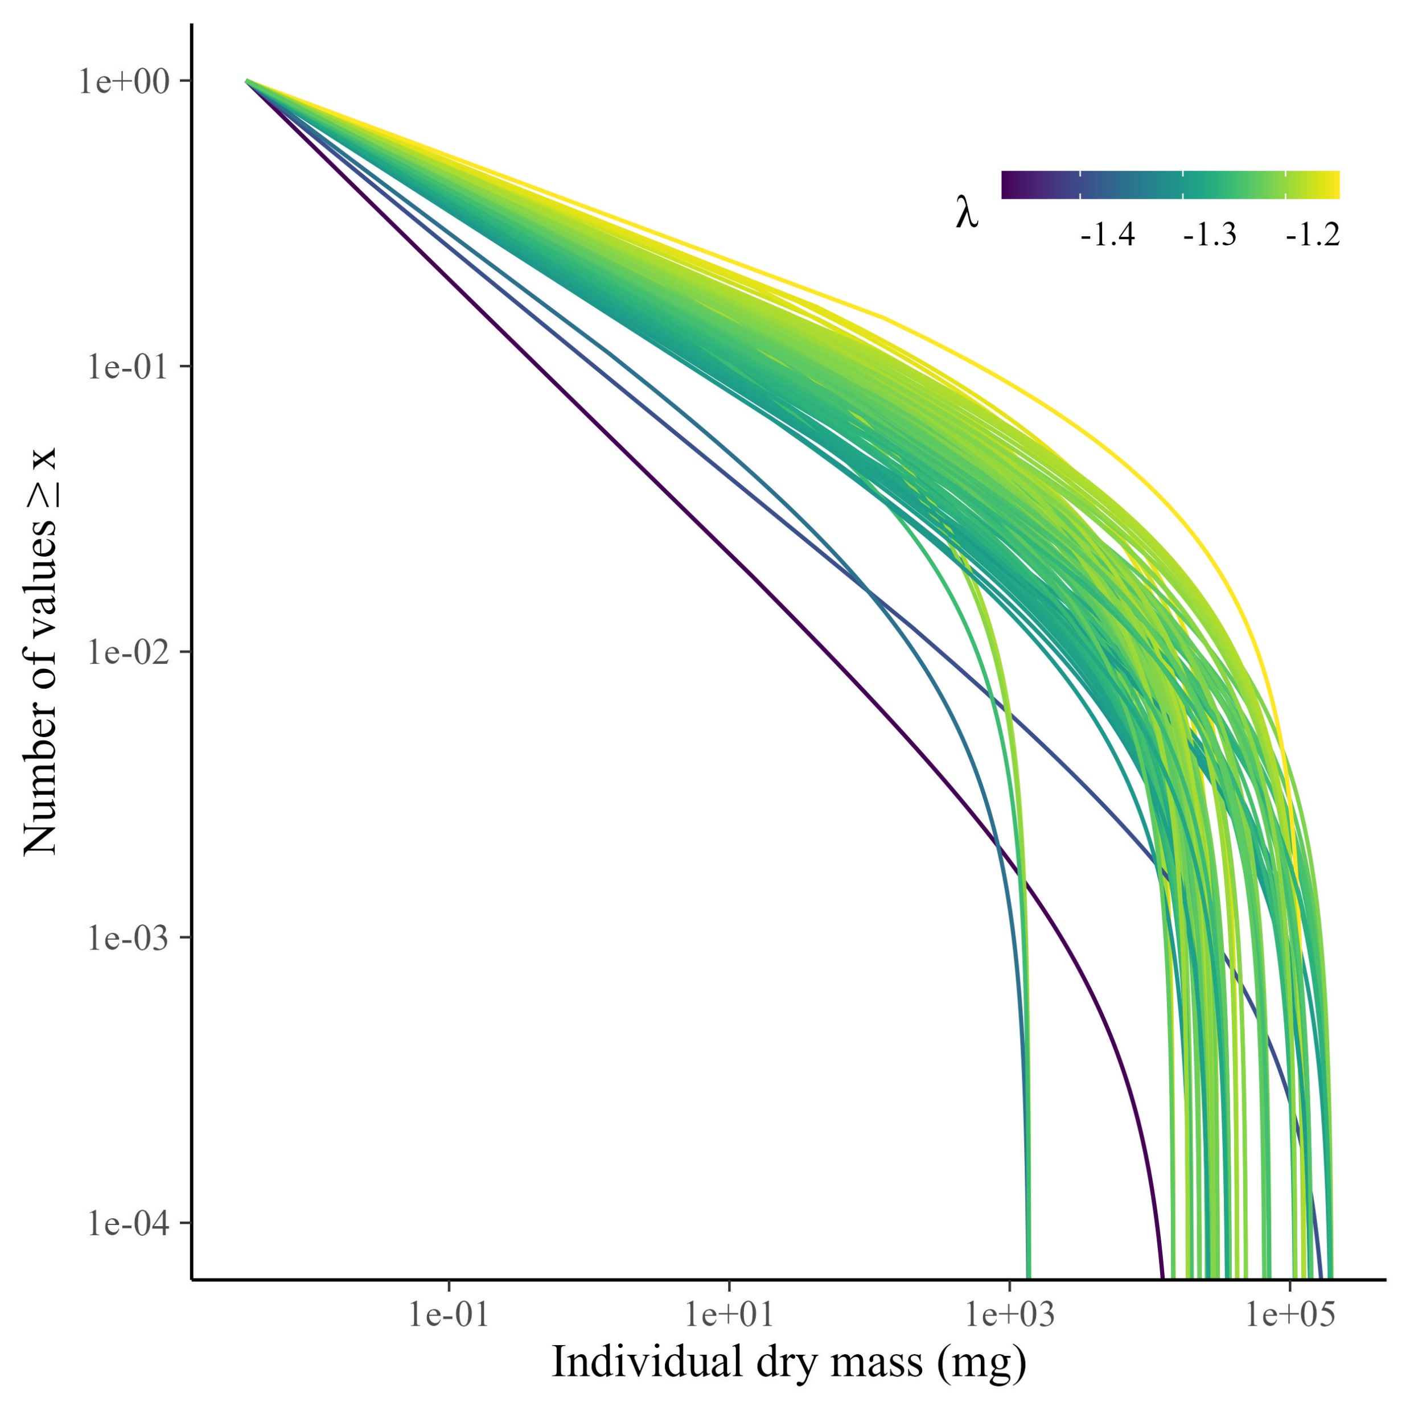
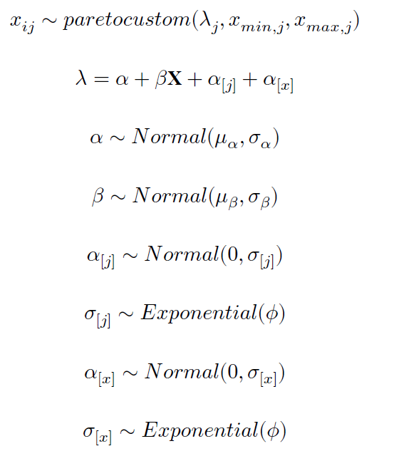
Modeling
Wesner, J. S., Pomeranz, J. P., Junker, J. R., & Gjoni, V. (2023). Bayesian hierarchical modeling of size spectra. bioRxiv, 2023-02.

Slide 12
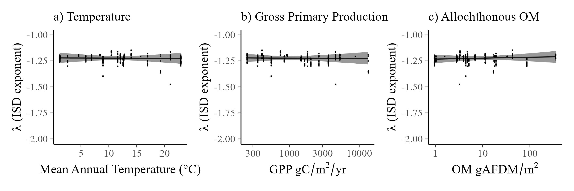
No change in the ISD. Values are consistently ~ -1.22
(Conditional relationships from multiple regression model with temperature, gpp, om, and their interactions)
Notes:
Fix y-axis height

Slide 13
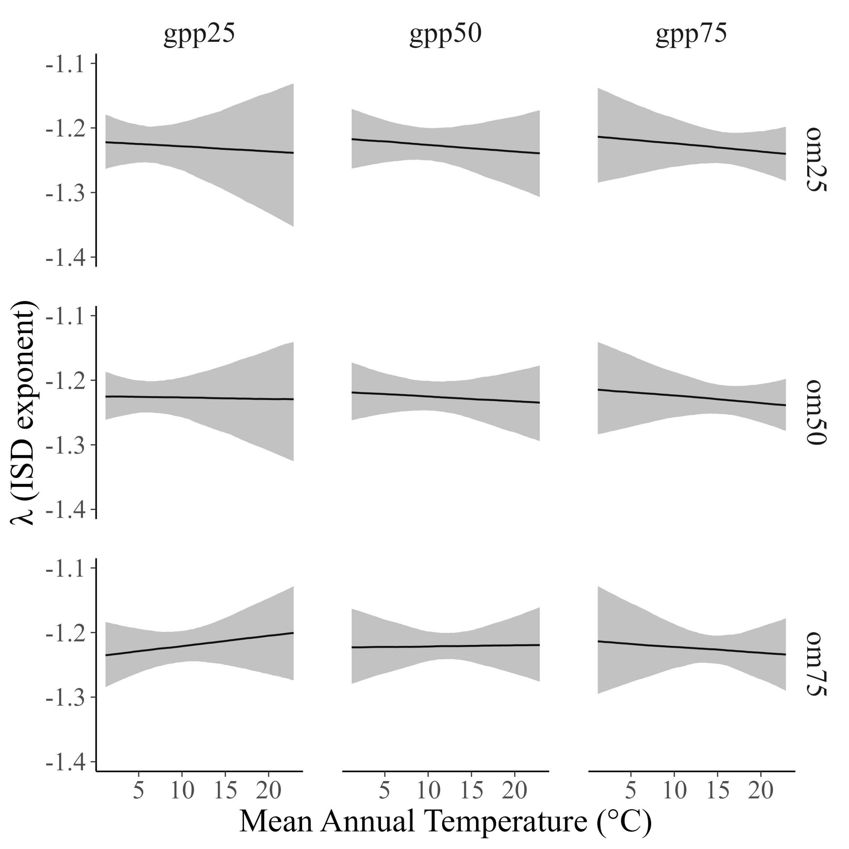
No interactions with gpp x om x temperature
Notes:
Lack of change with temperature suggest that any temperature related increases in metabolic demand are met by resource supply from GPP or OM. In addition, while mean body sizes might decline (indeed they do for fish) at higher temperatures, the invariance of the ISD indicates no effect of mean mass decline on the relative distribution of individual body sizes. It’s worth emphasizing that these systems have had similar temperatures for 15000 years, with presumed adaptation of the organisms in them, so it’s not clear that temperature is a “stressor” in this macroscale study.

Slide 14
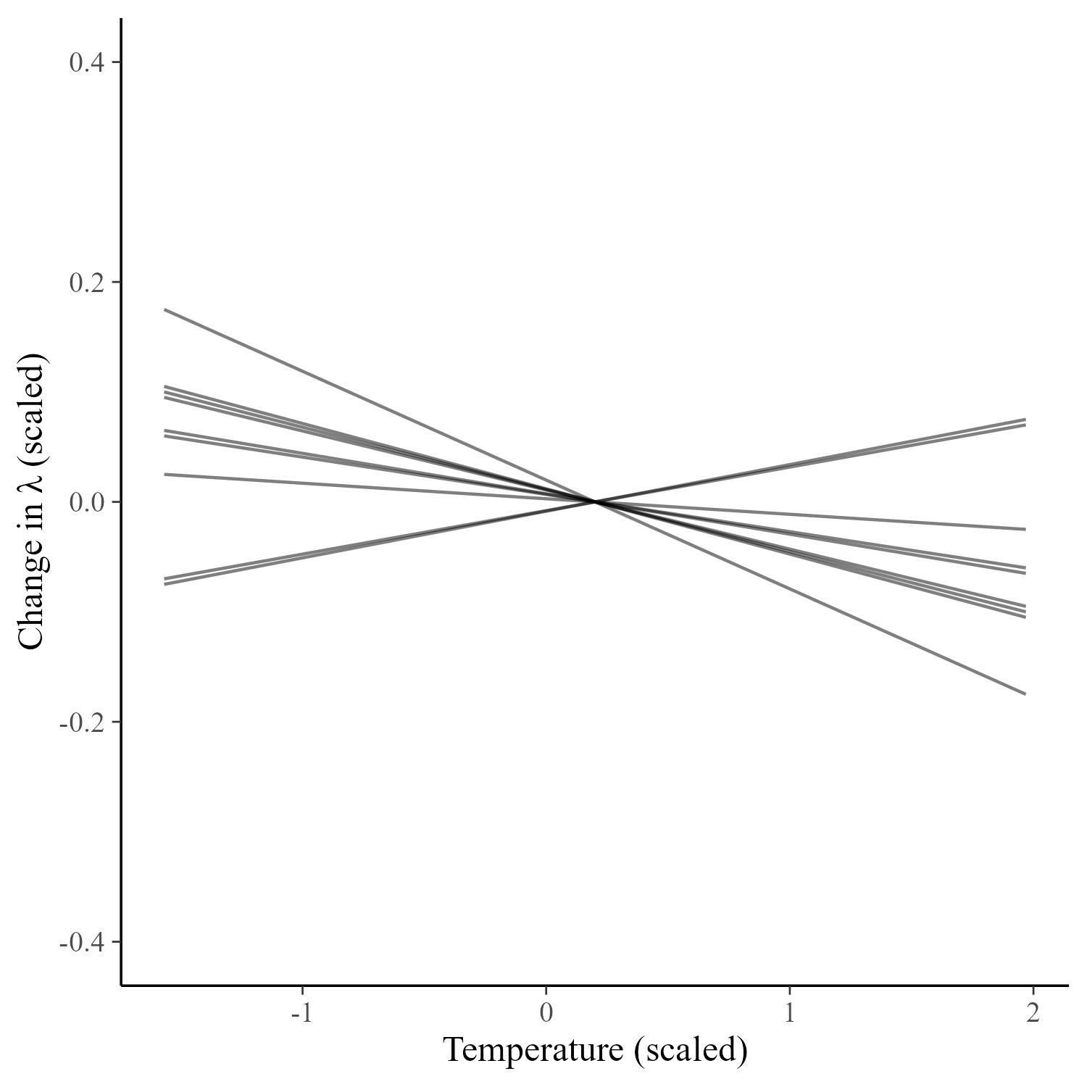
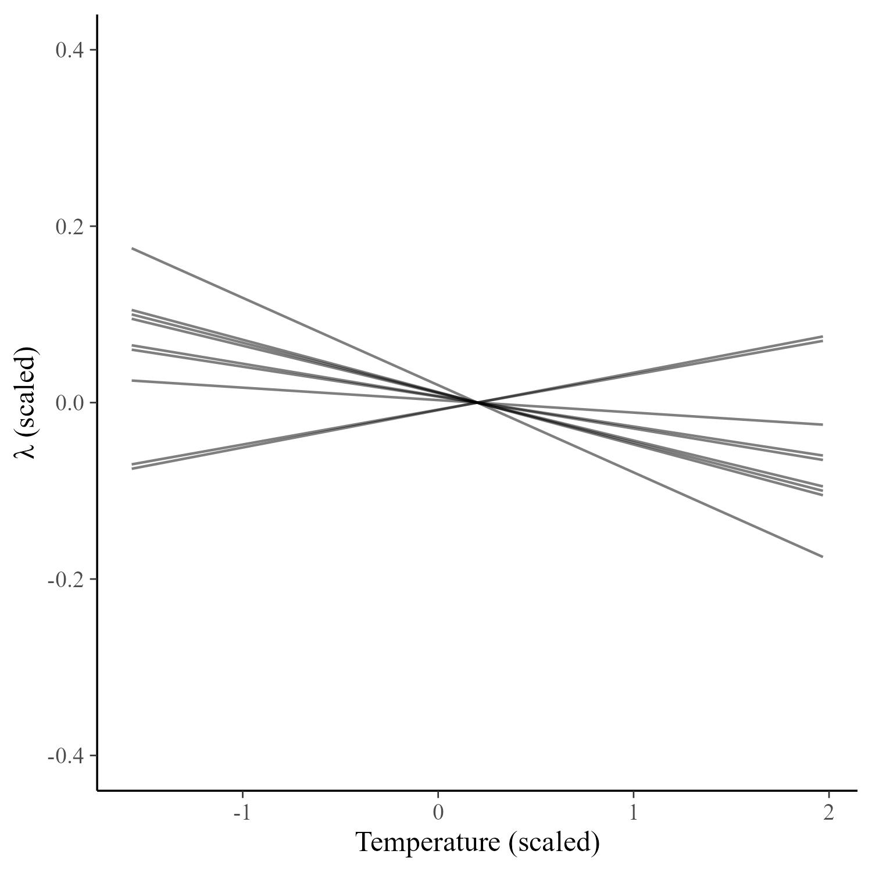
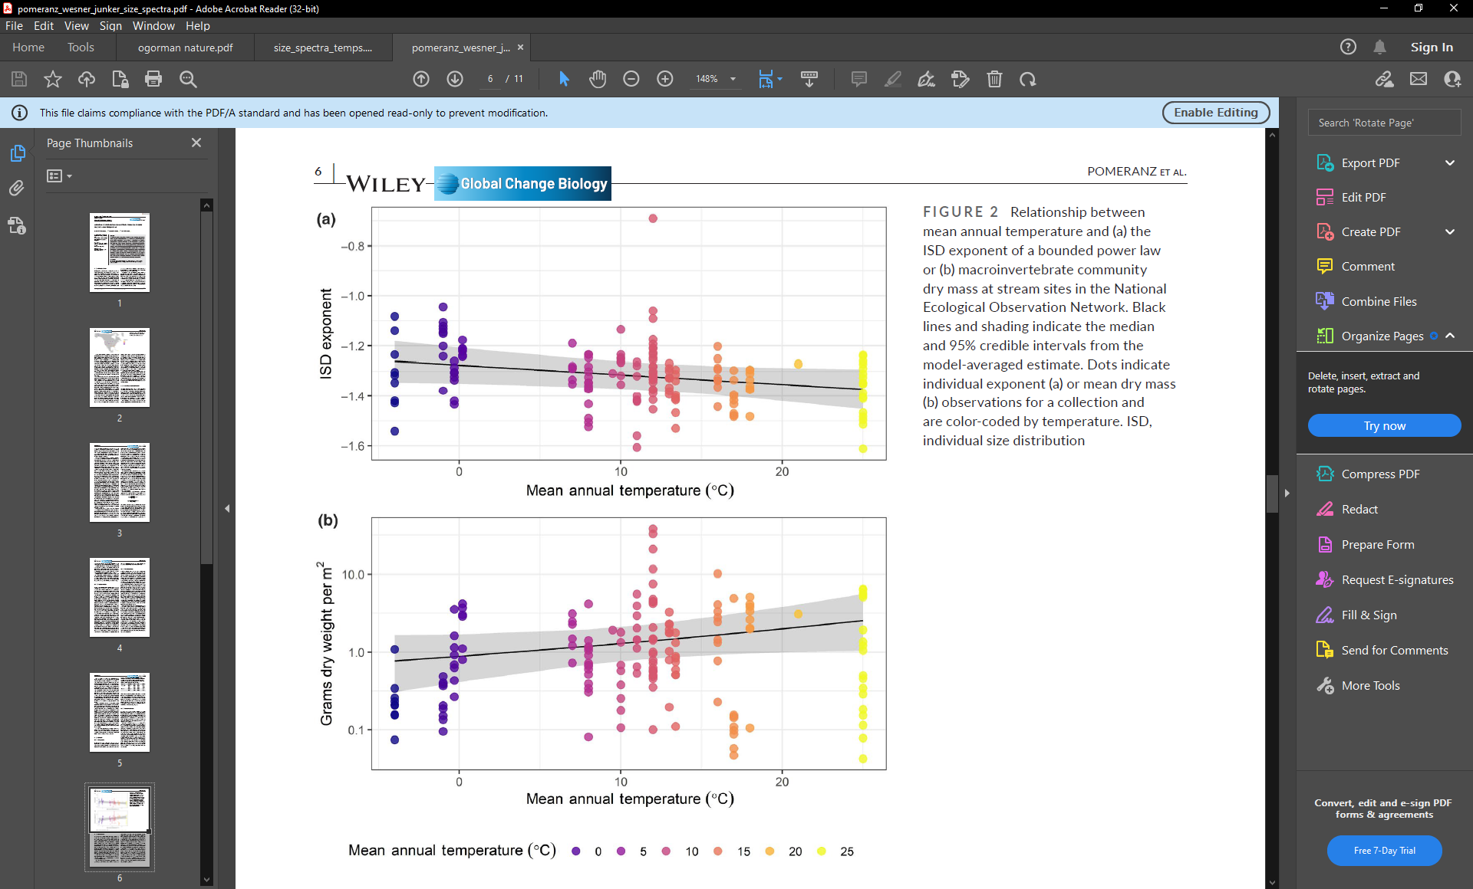
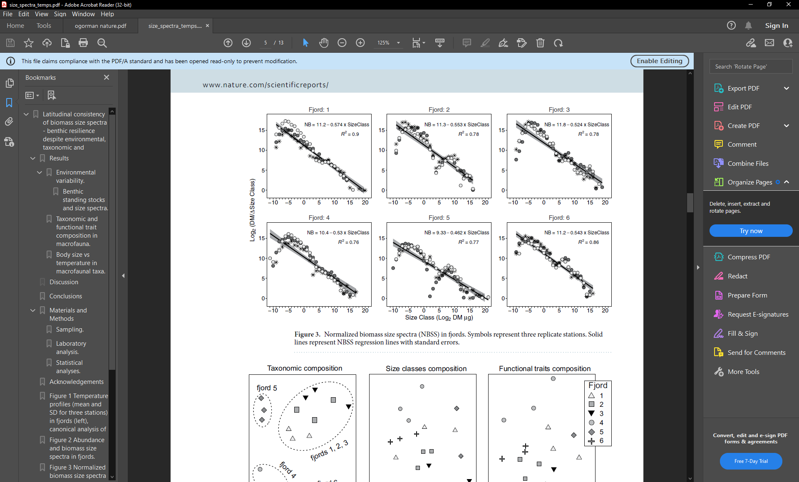
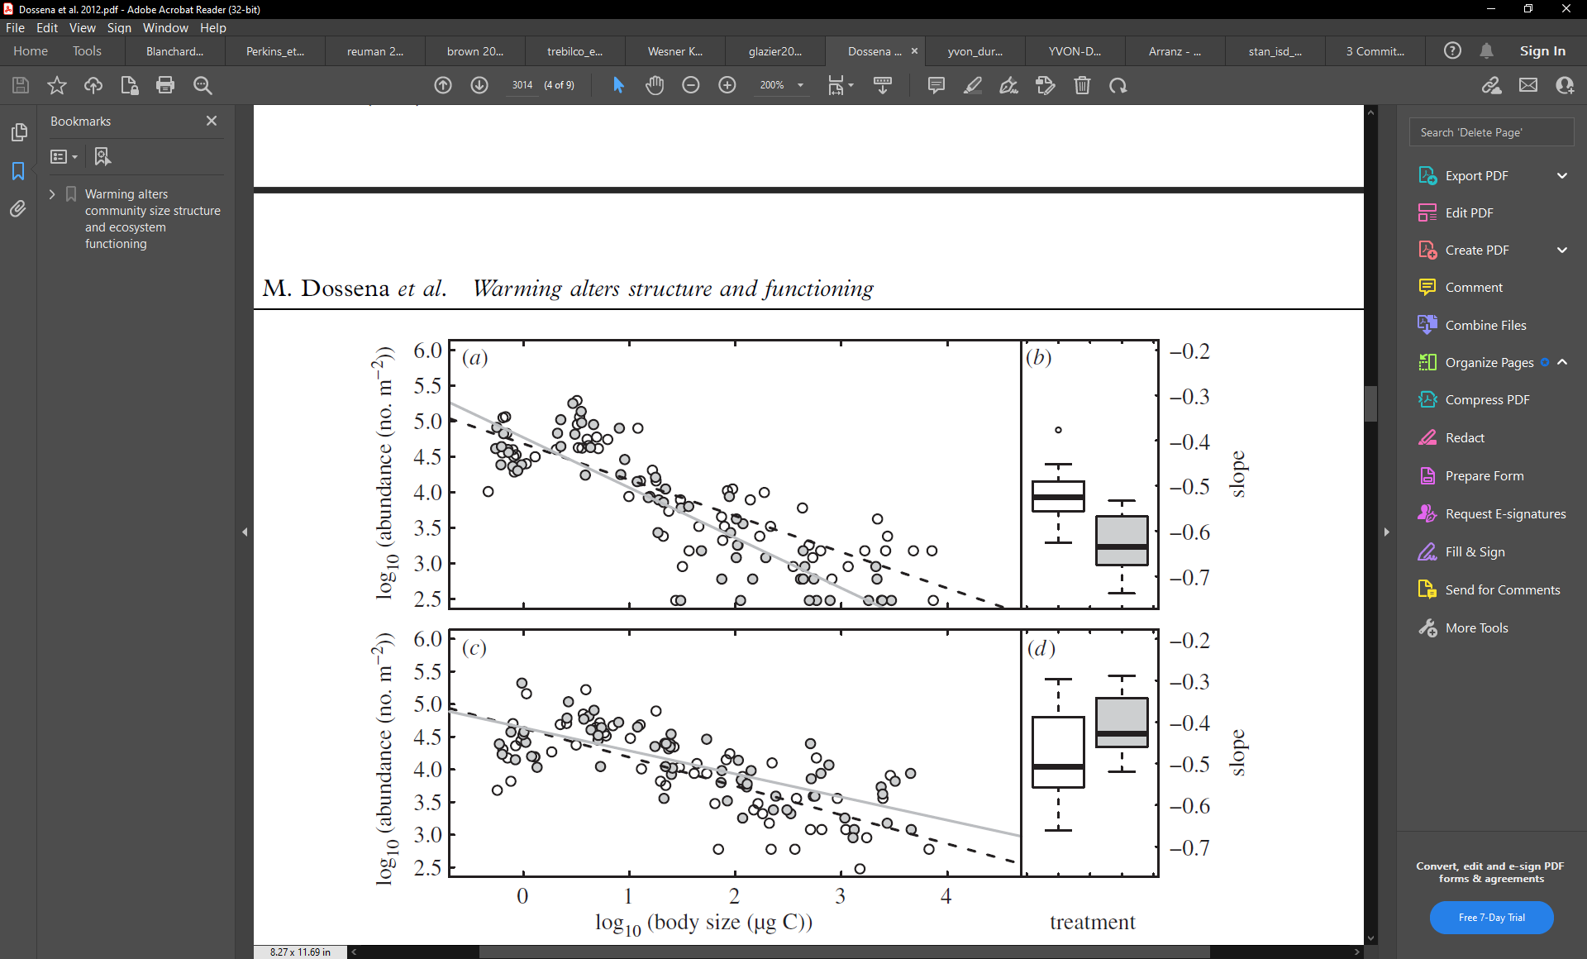
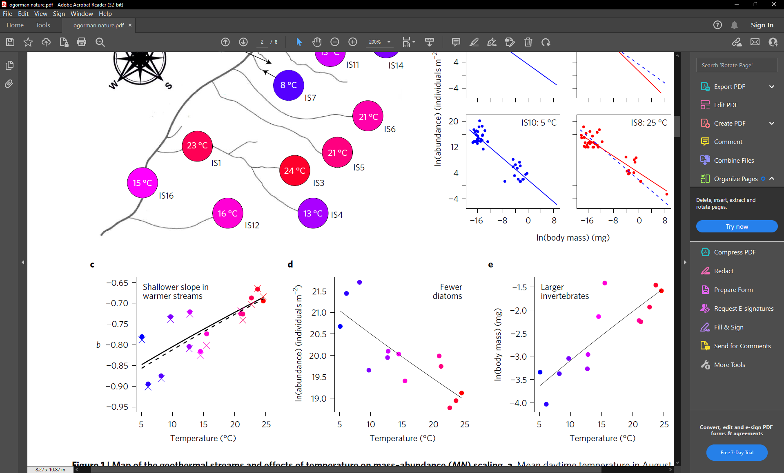
Back to the literature….How big are temperature effects on size spectra?

Slide 15
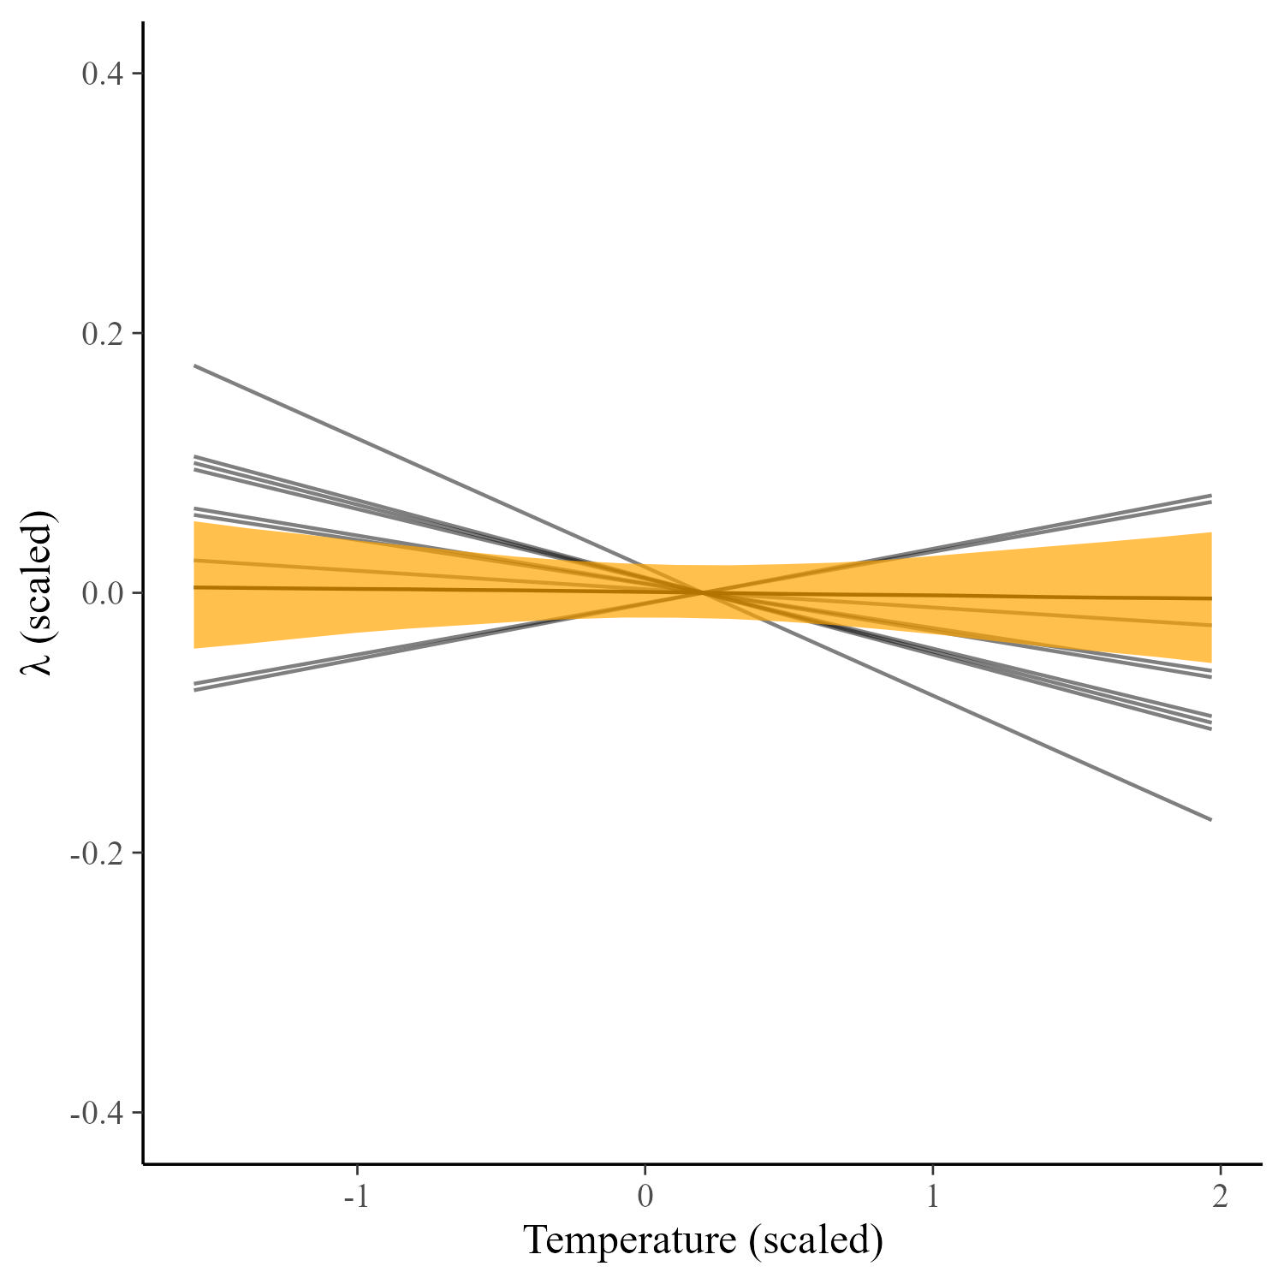
Back to the literature….How big are temperature effects on size spectra?

Slide 16
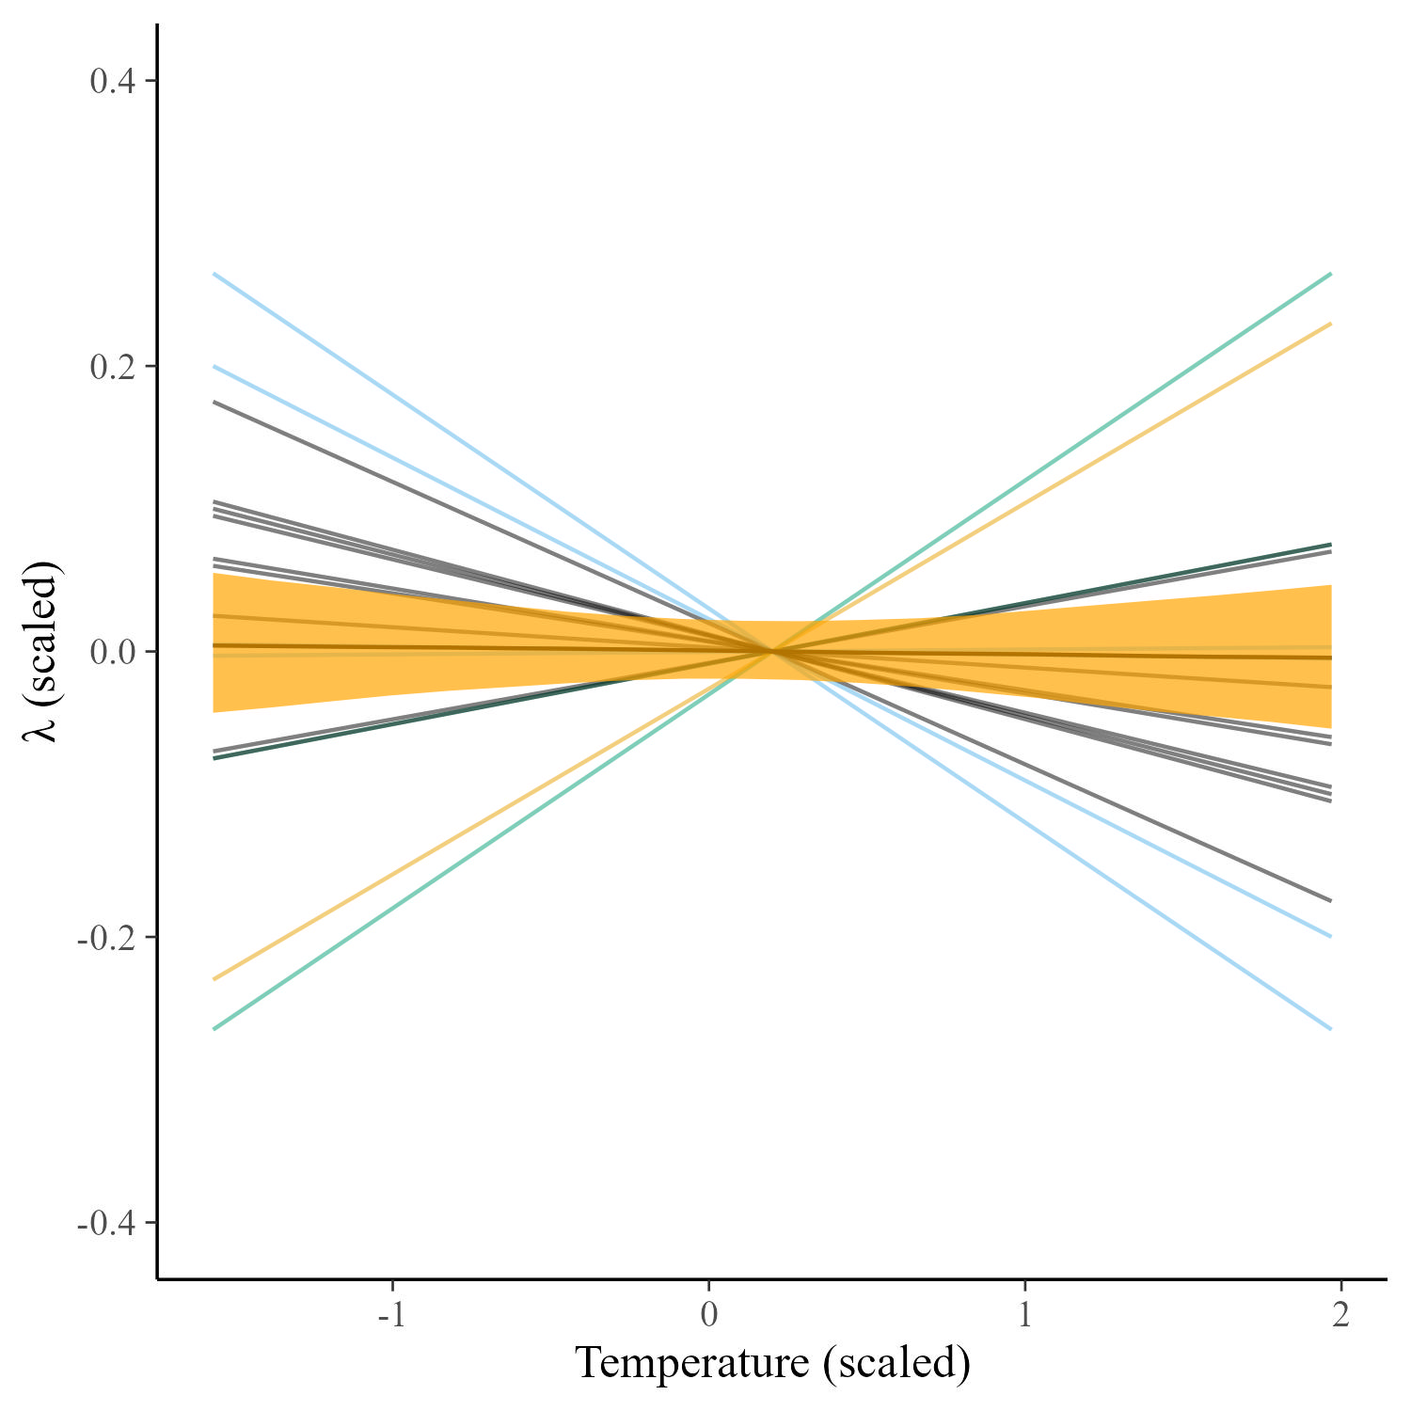
Back to the literature….How big are temperature effects on size spectra?
Acid Mine Drainage
Land use
Overfishing
Stressor (scaled)

Slide 17
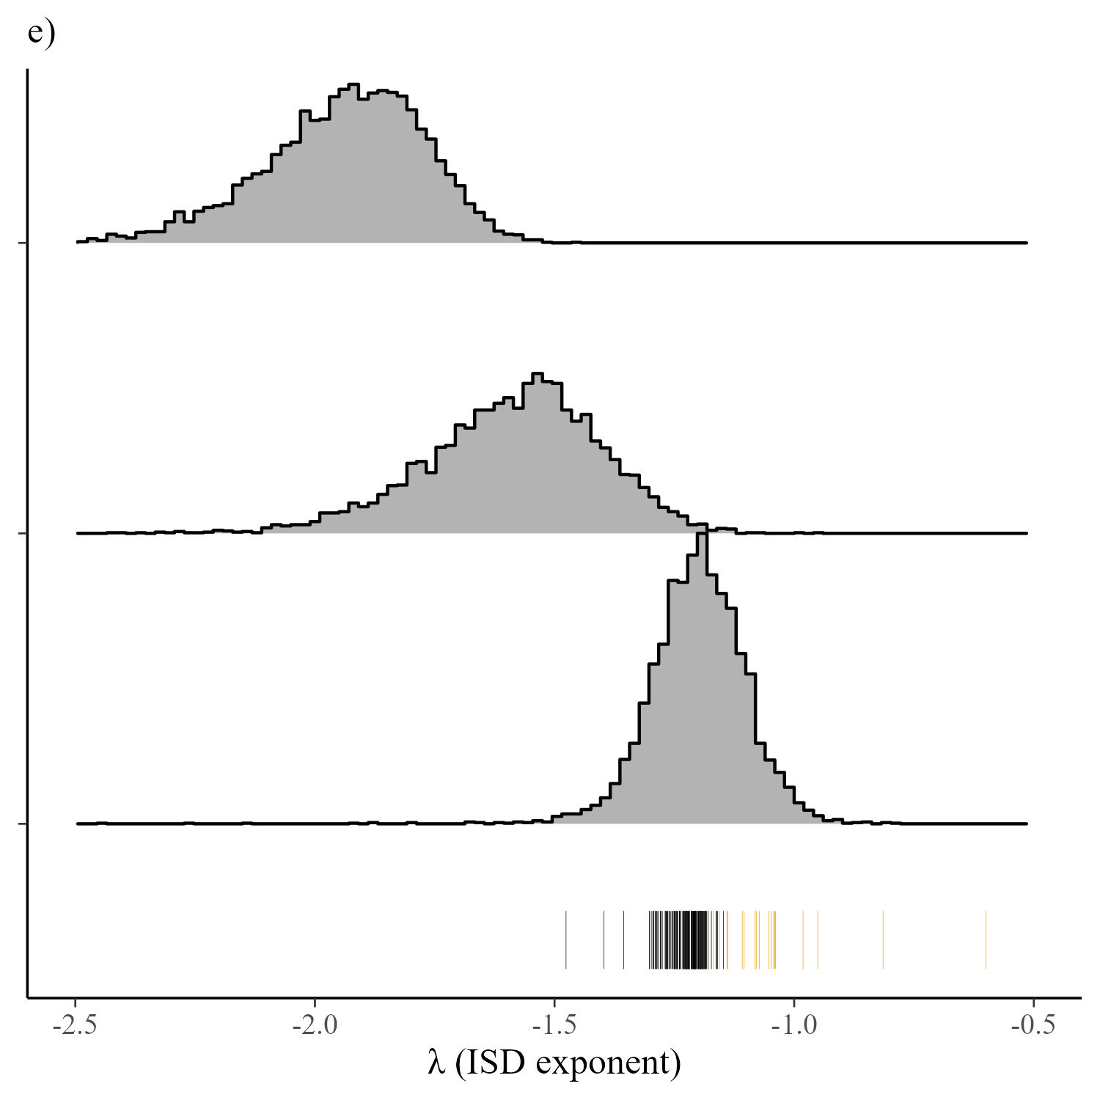

Back to the literature….How big are temperature effects on size spectra?
Why is lambda -1.2?
λ $=\frac{log⁡(TE)}{log⁡(PPMR)}−0.75$
Empirical values

Slide 18

Back to the literature….How big are temperature effects on size spectra?
Why is lambda -1.2?
λ $=\frac{log⁡(0.05 to 0.2)}{log⁡({10}^{2}to{10}^{7})}−0.75$
λ $=\frac{log⁡(0.05 to 0.2)}{log⁡({10}^{2}to 10^7)}−0.75+ subsidies to fish$
λ $=\frac{log⁡(0.05 to 0.2)}{log⁡({10}^{2}to 10^7)}−(0.3 to 0.5)+subsidies to fish$
Empirical values
$$Perkins et al. 2018 (0.2 to 0.5 increase)$$

Slide 19
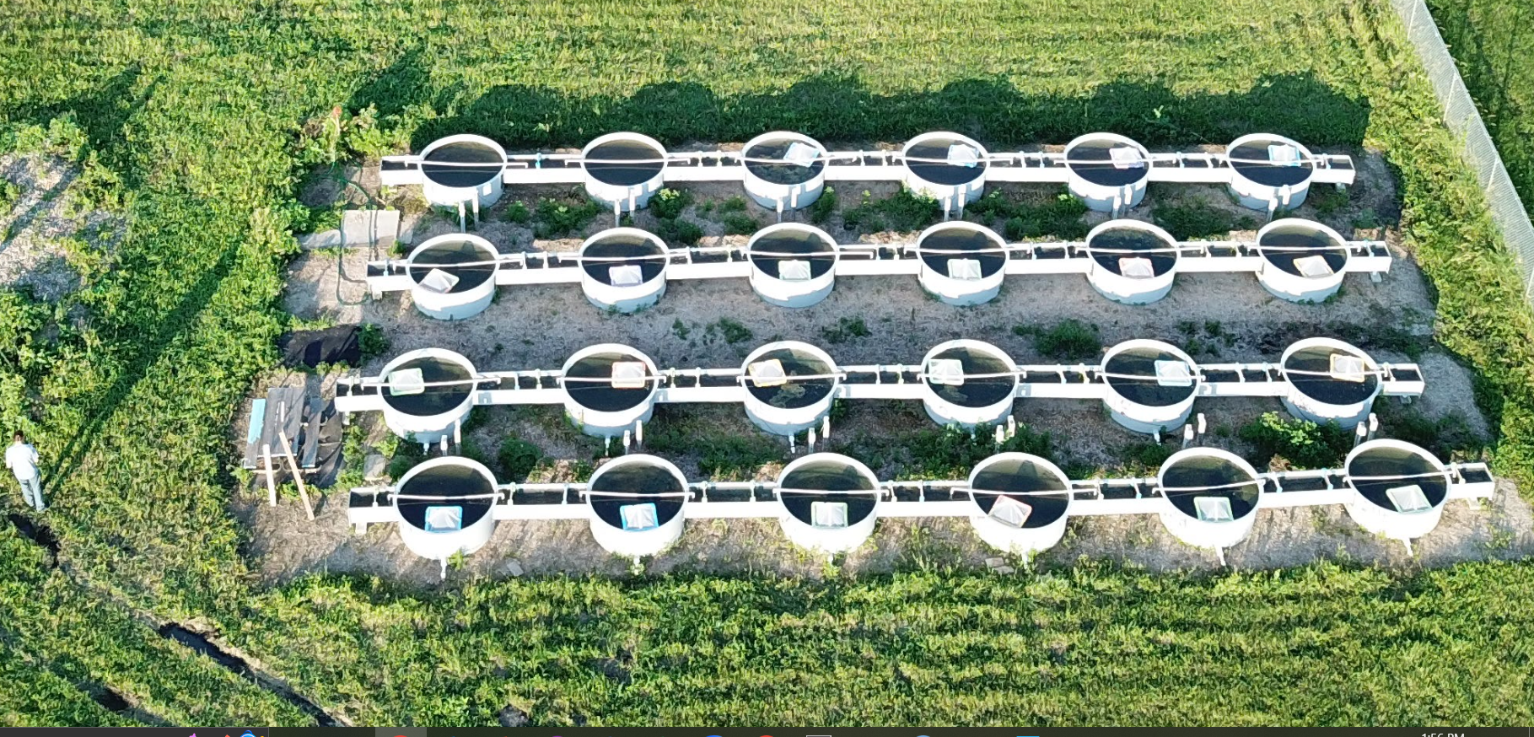
Mesocosm experiment
(July 2023)

Slide 20
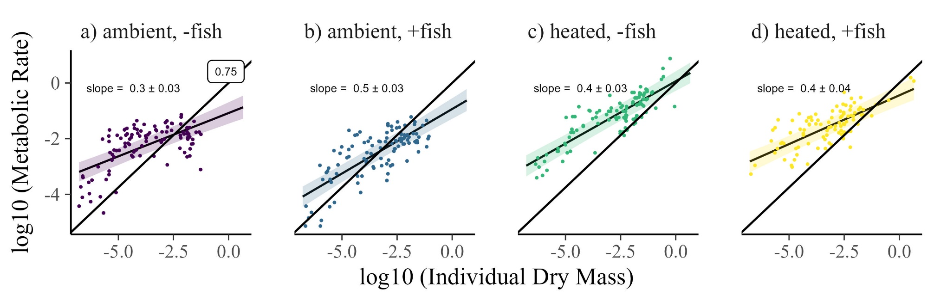
Mesocosm experiment supports metabolic-mass exponent of ~0.4

Slide 21
Conclusions
ISD’s are invariant across freshwater streams
Values ~ -1.3 to -1.15
Influence of subsidies and shallow metabolic scaling?
Unrelated to temperature and resources
Notes:
Universal indicator – excited to test this – for example, Yellowstone flood, BLDE – Where will it be on that? https://www.youtube.com/watch?v=0Mp91KWiVlA

Slide 22

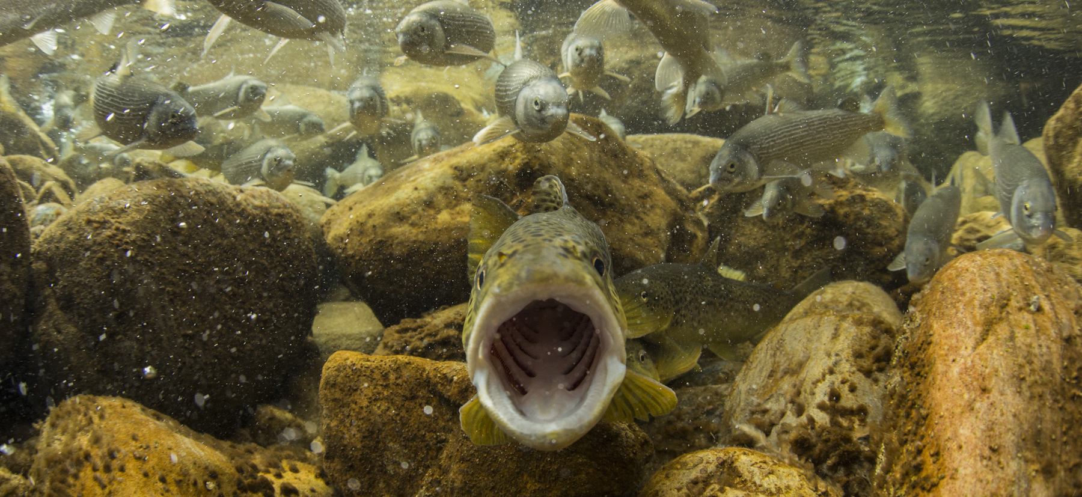


Thank You!
Grants: 2106067 and 2106068

Slide 23
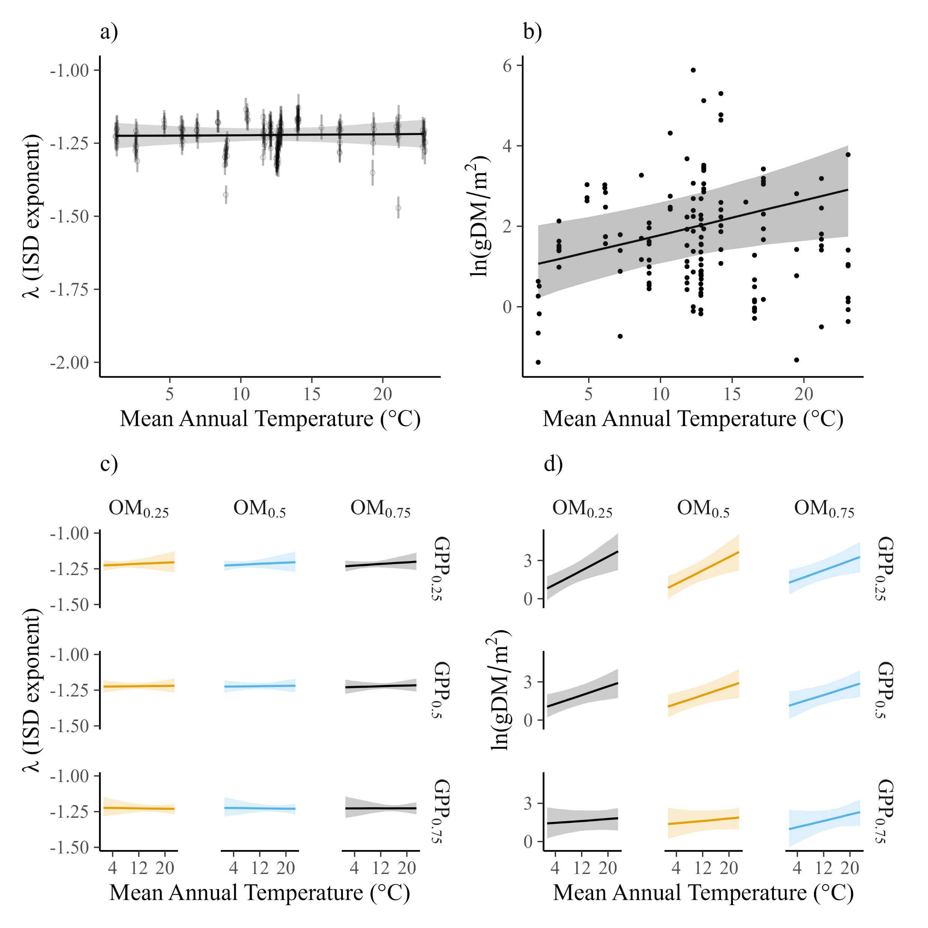
Weak linear increase in standing biomass. Moderated by resource supply.

Slide 24
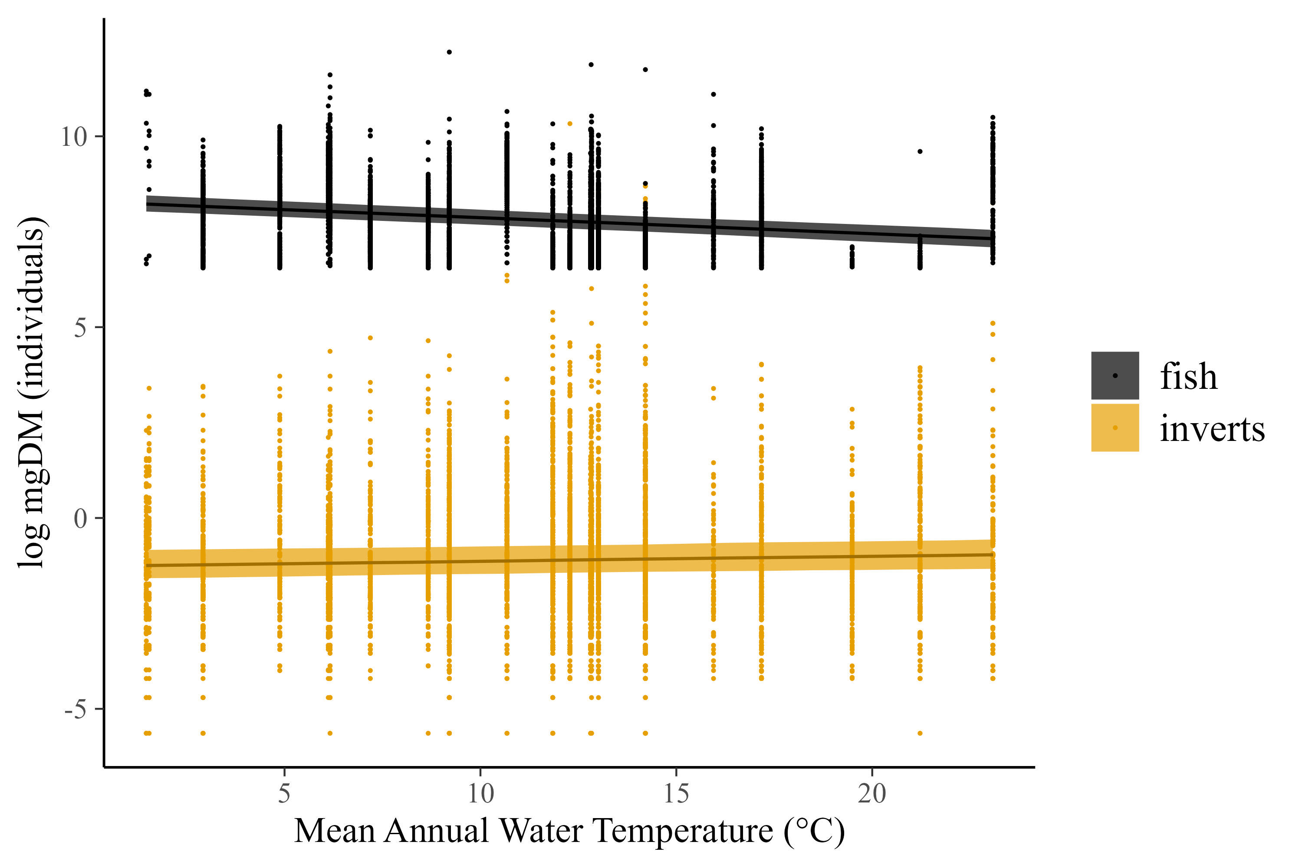
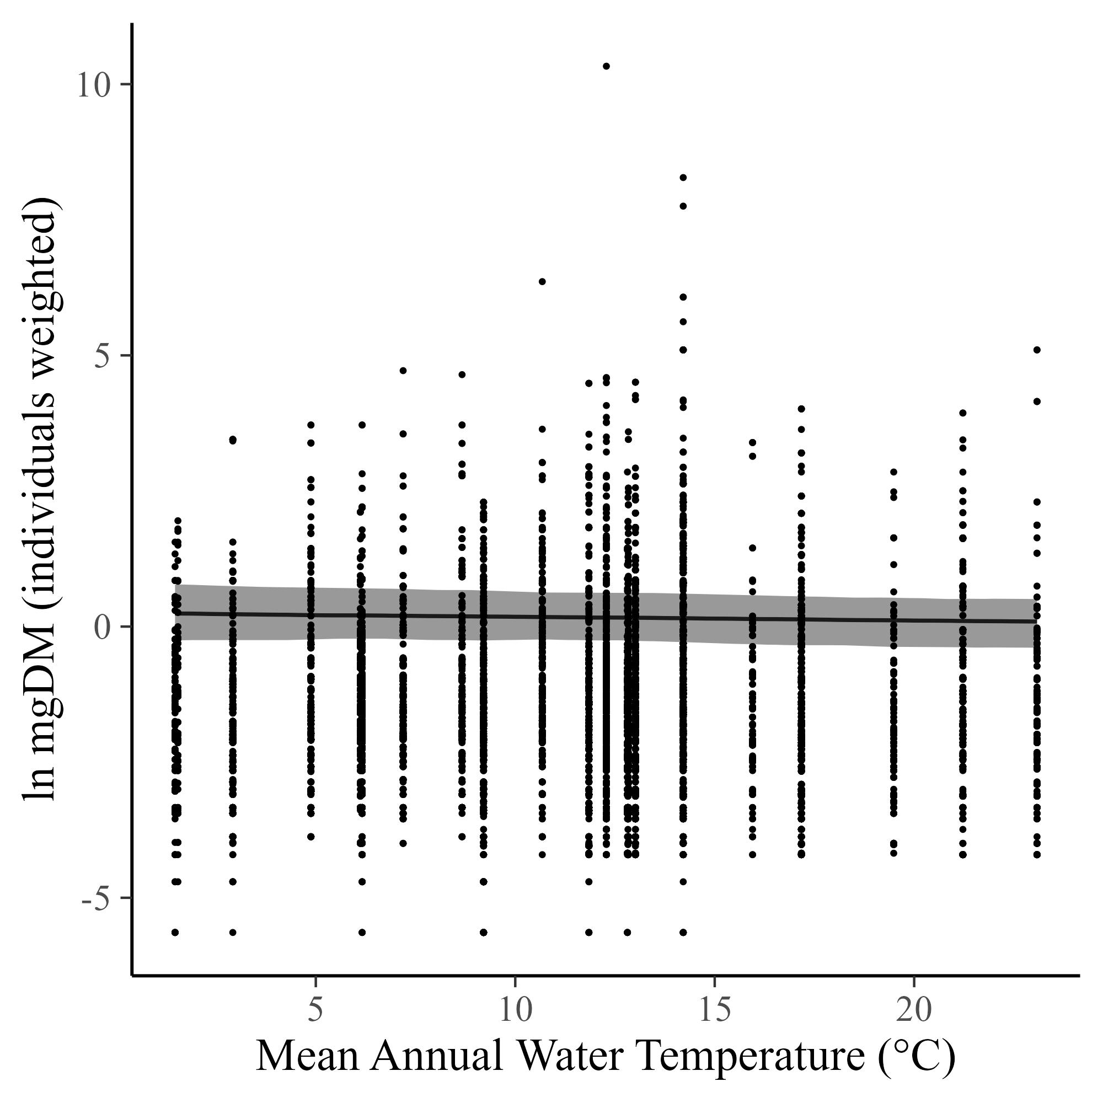
Fish got smaller with increasing temperature, but not invertebrates.

Slide 25
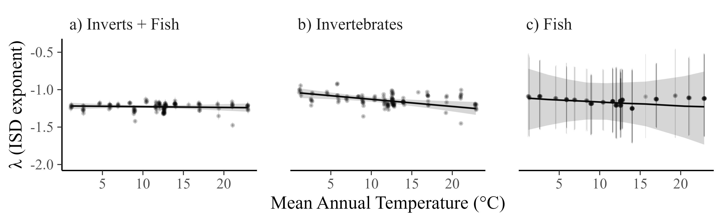
Fish and Inverts separately

Slide 26
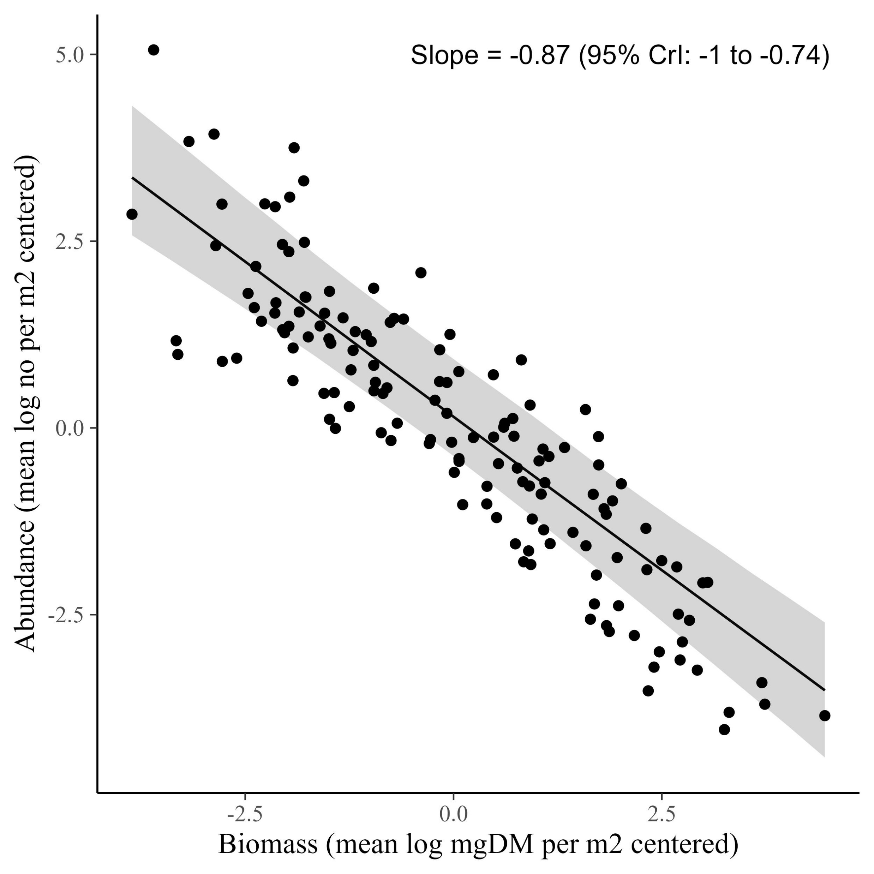
CCSR

Slide 27
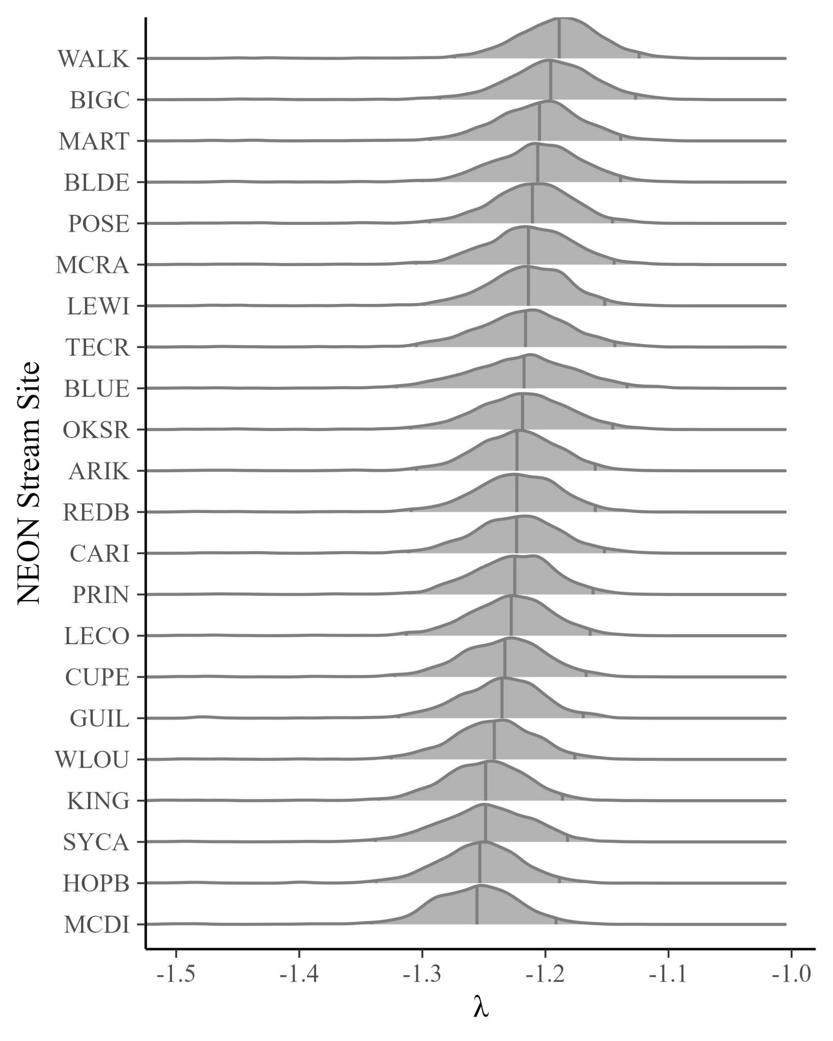
Forecasting the ISD
Future λ’s should be between
-1.32 to -1.15 (predicted)
Notes:
Universal indicator – excited to test this – for example, Yellowstone flood, BLDE – Where will it be on that? https://www.youtube.com/watch?v=0Mp91KWiVlA

Slide 28
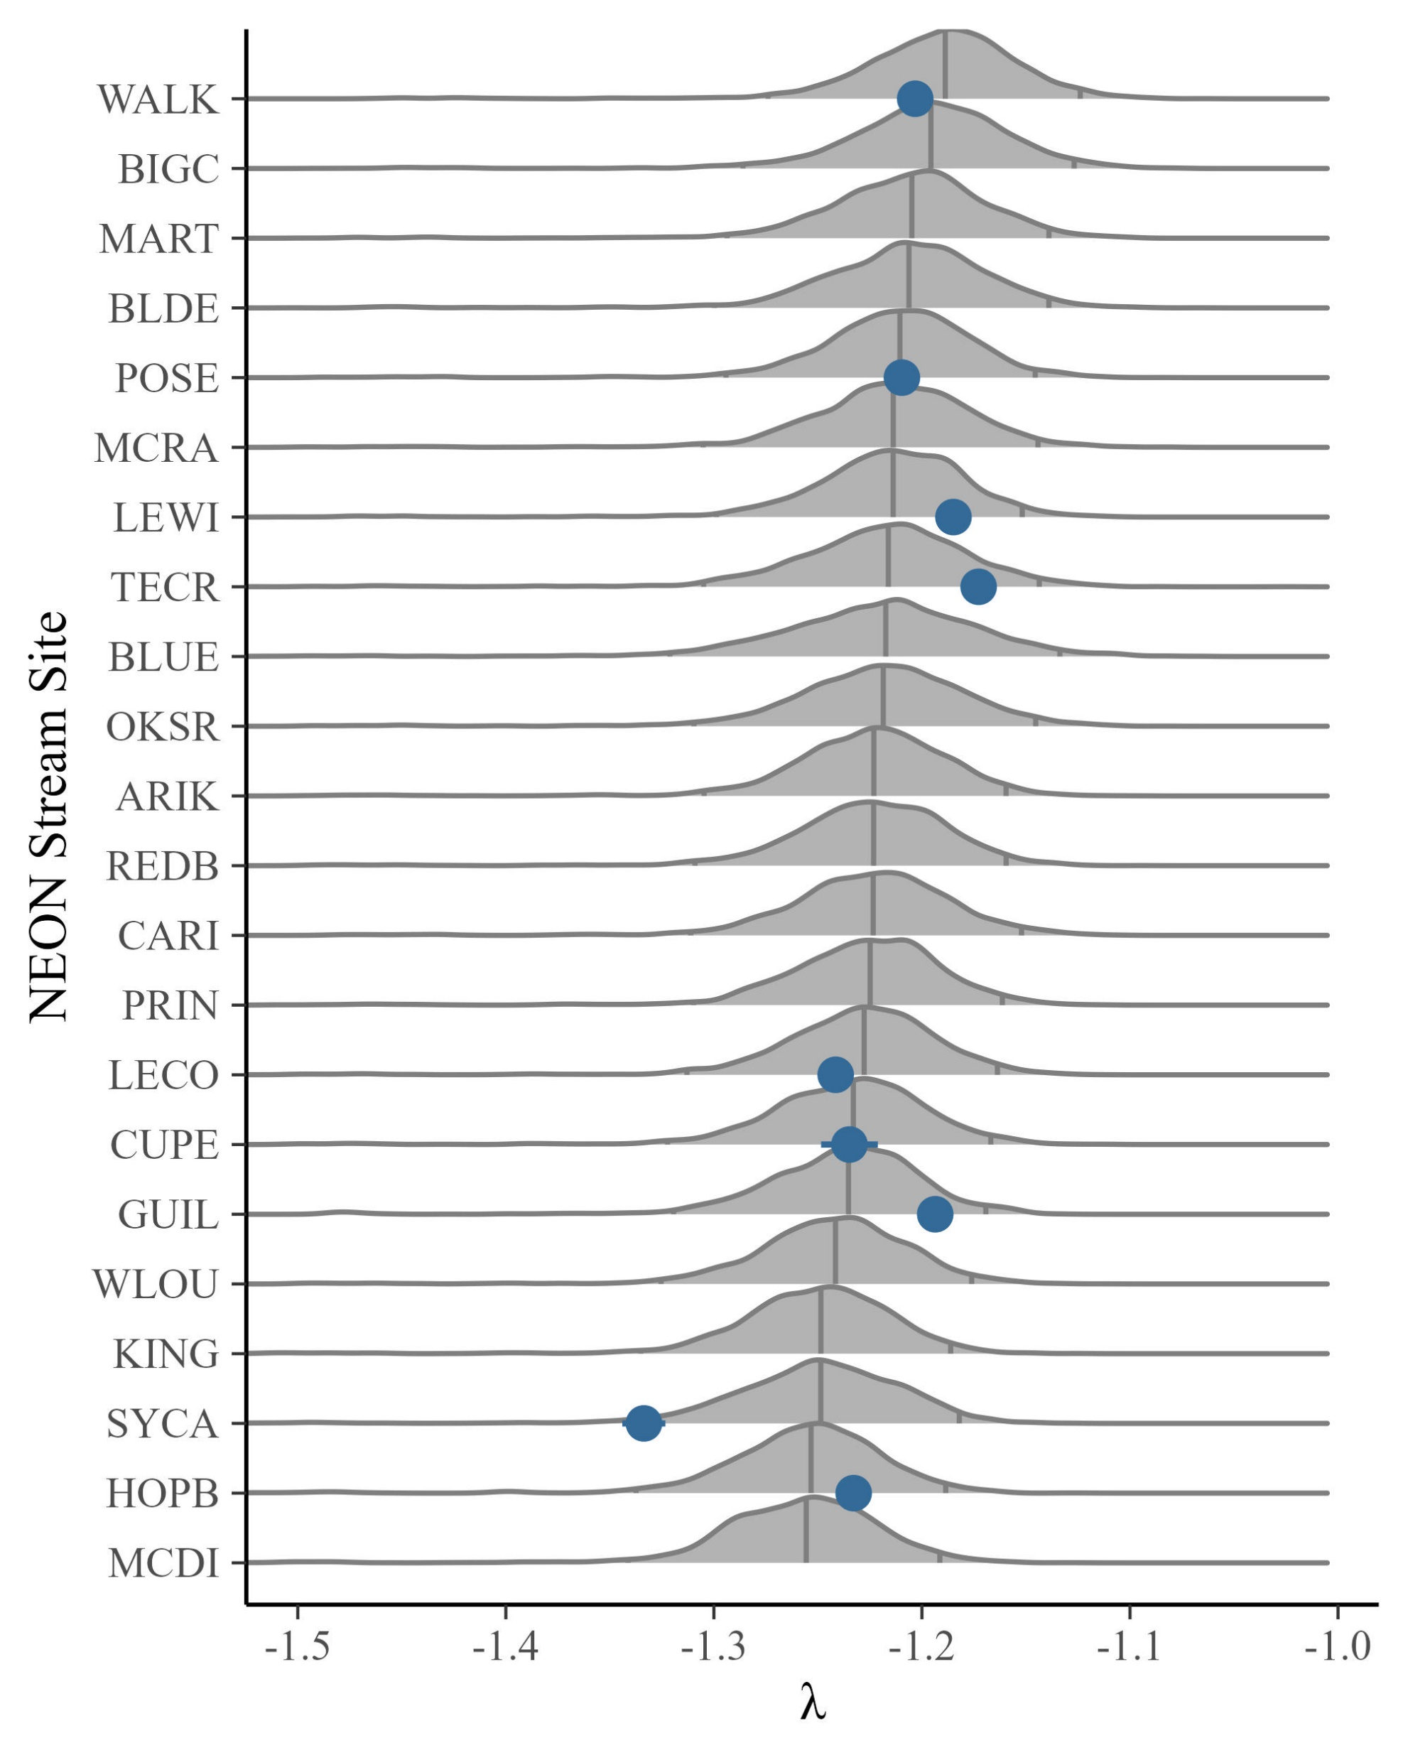
Forecasting the ISD
Future λ’s should be between
-1.32 to -1.15 (predicted)
-1.33 to -1.17 (observed – 2022)
Notes:
Universal indicator – excited to test this – for example, Yellowstone flood, BLDE – Where will it be on that? https://www.youtube.com/watch?v=0Mp91KWiVlA

Slide 29
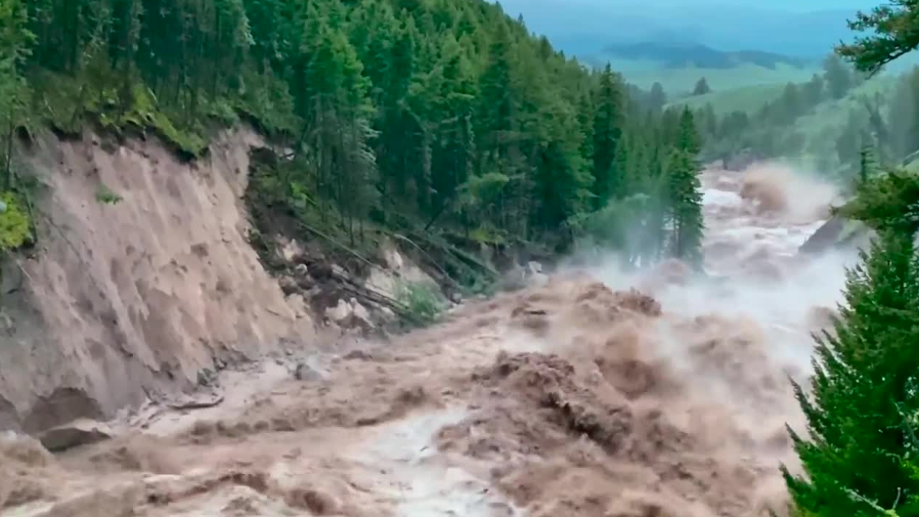

Forecasting the ISD – Detecting ecosystem changes
1,000 year flood in 2022
Notes:
Universal indicator – excited to test this – for example, Yellowstone flood, BLDE – Where will it be on that? https://www.youtube.com/watch?v=0Mp91KWiVlA

Slide 30
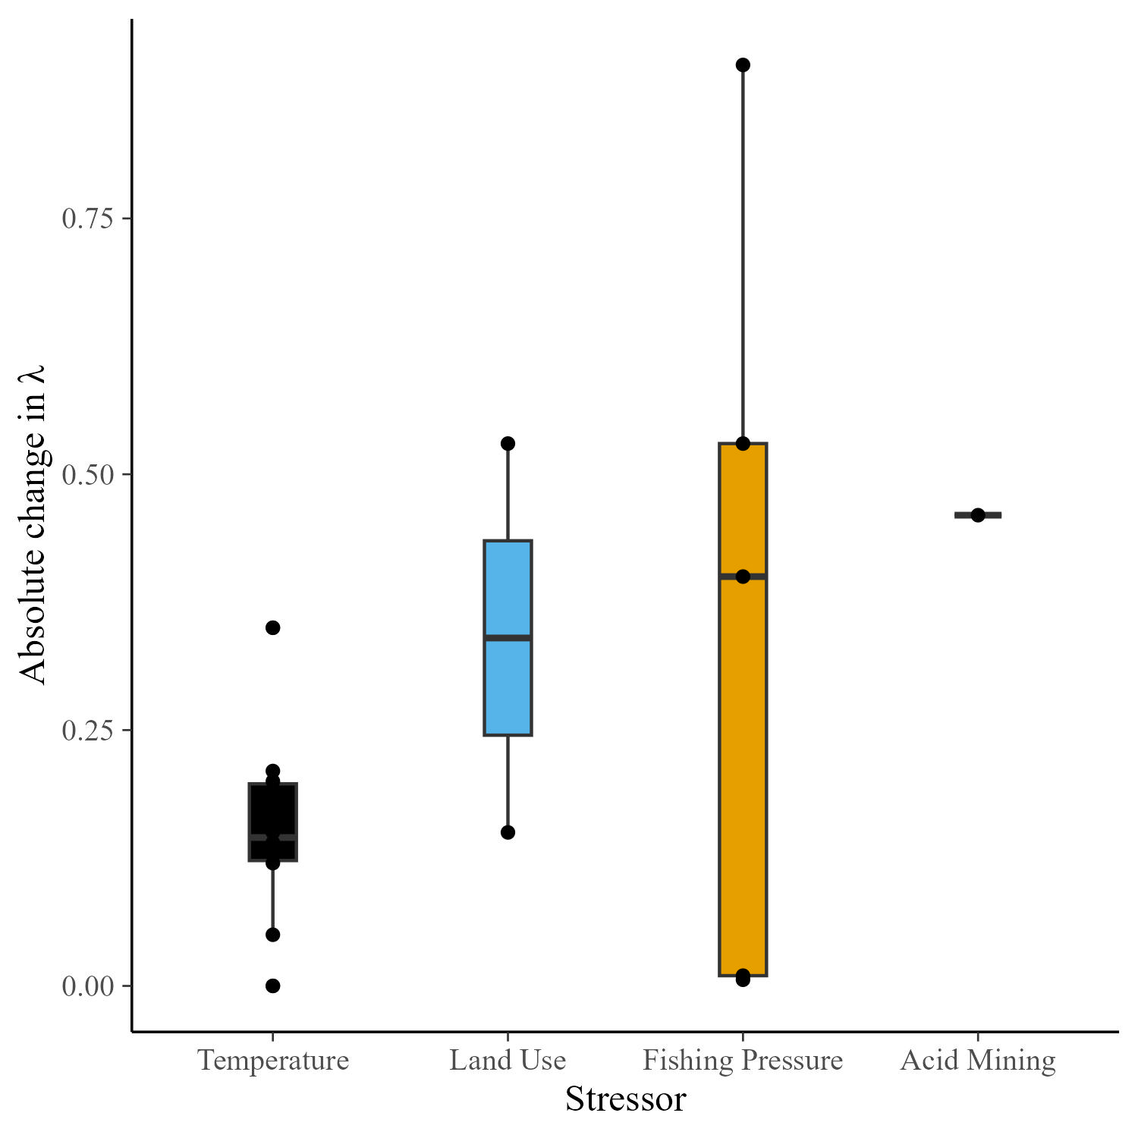
Back to the literature….How big are temperature effects on size spectra?

Slide 31
Thank you!
2106067 and 2106068

Slide 32
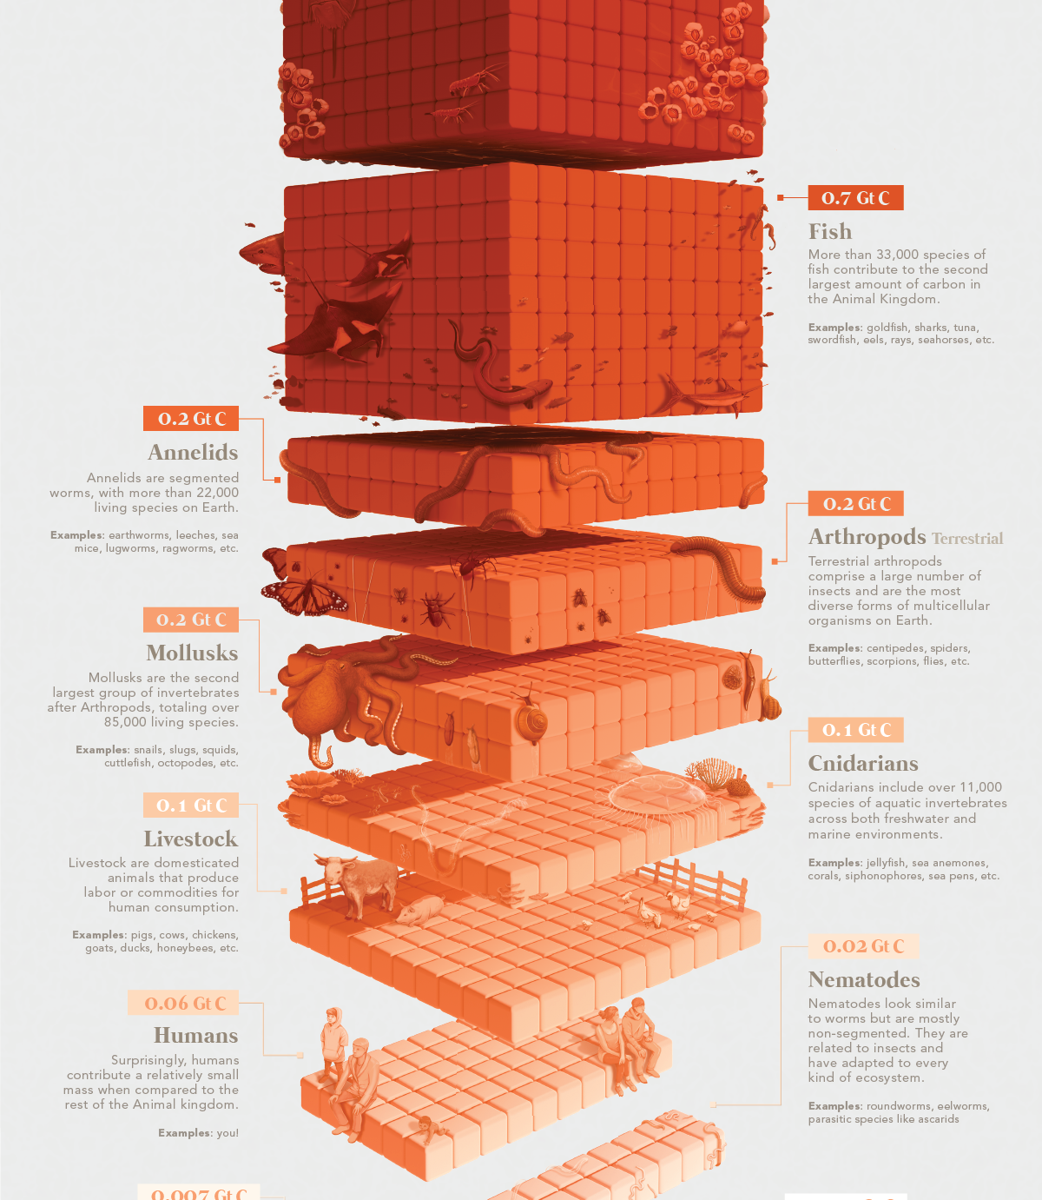

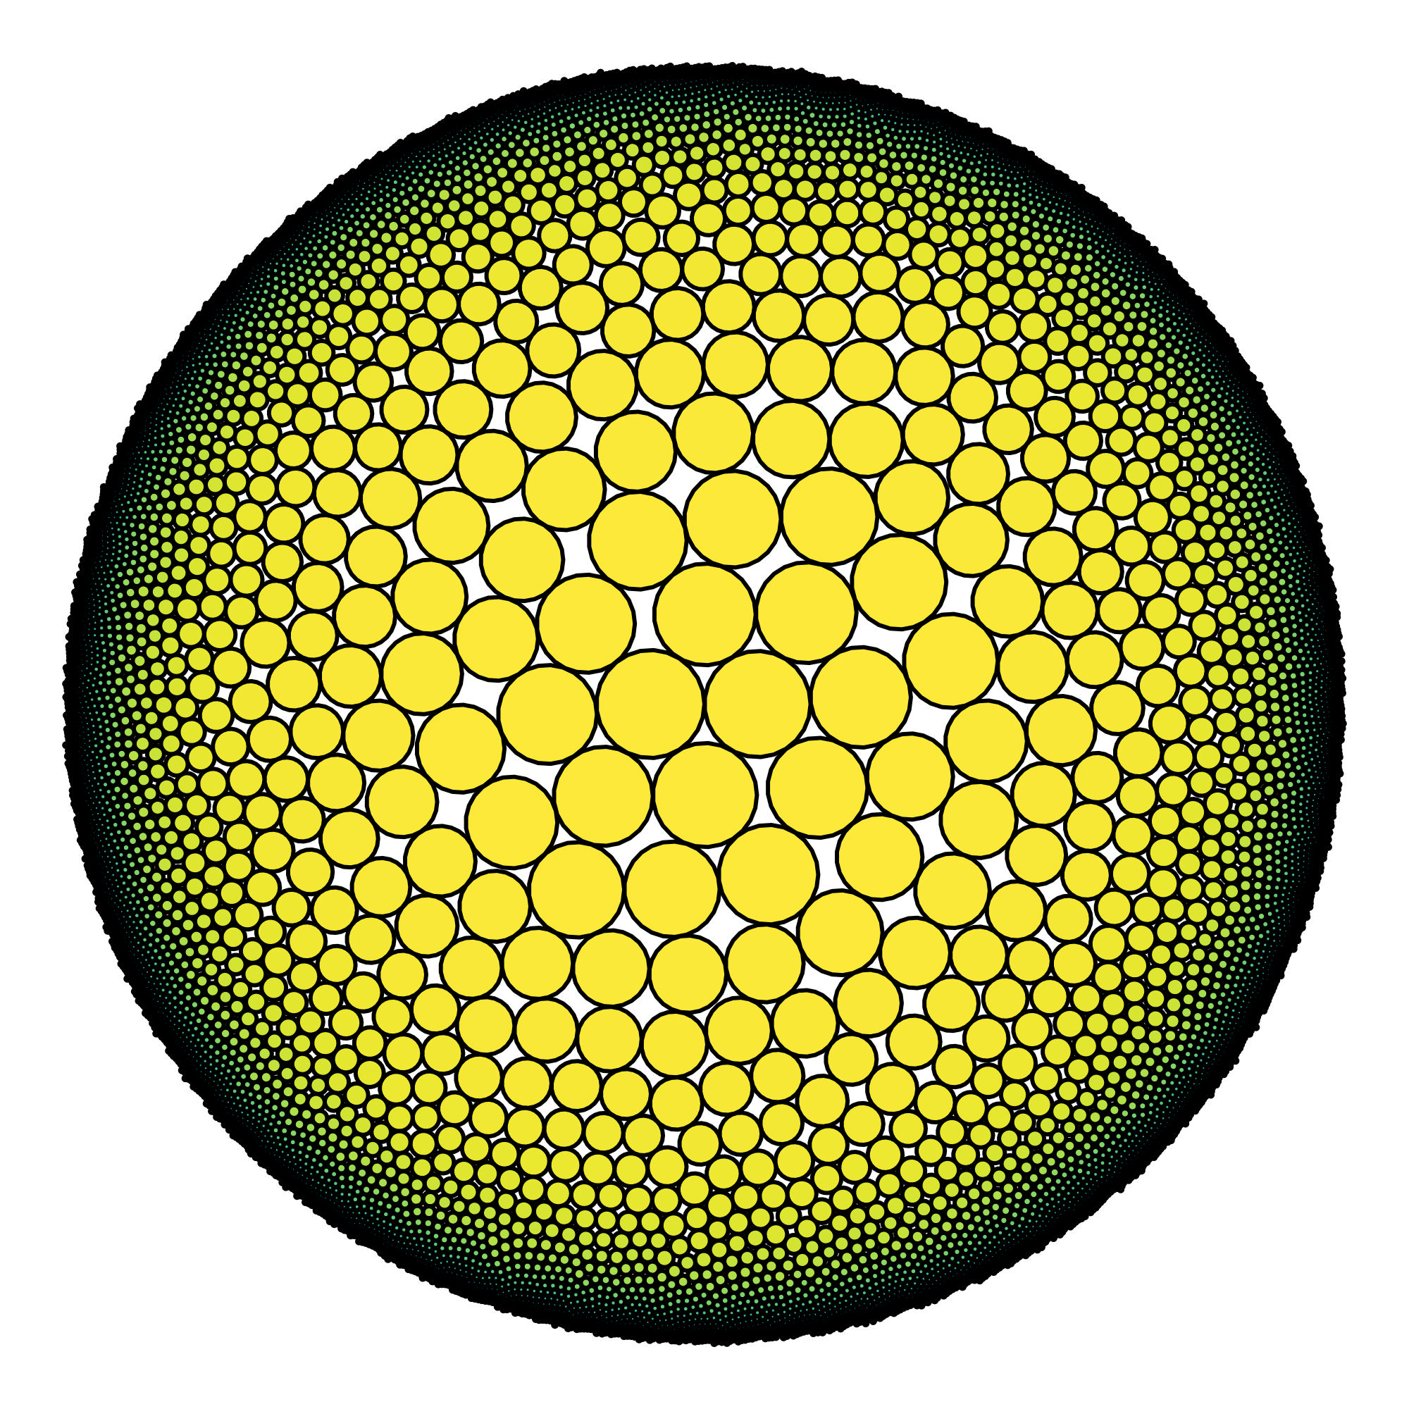
1.1 trillion tons of living mass on earth
1 nonillion individuals
Large individuals are more rare than small individuals
Elhacham, E., et al. (2020). Nature, 588(7838), 442-444.
Bar-On, Y. M., et al. (2018. Proceedings of the National Academy of Sciences, 115(25), 6506-6511.
https://www.visualcapitalist.com/all-the-biomass-of-earth-in-one-graphic/

Slide 33
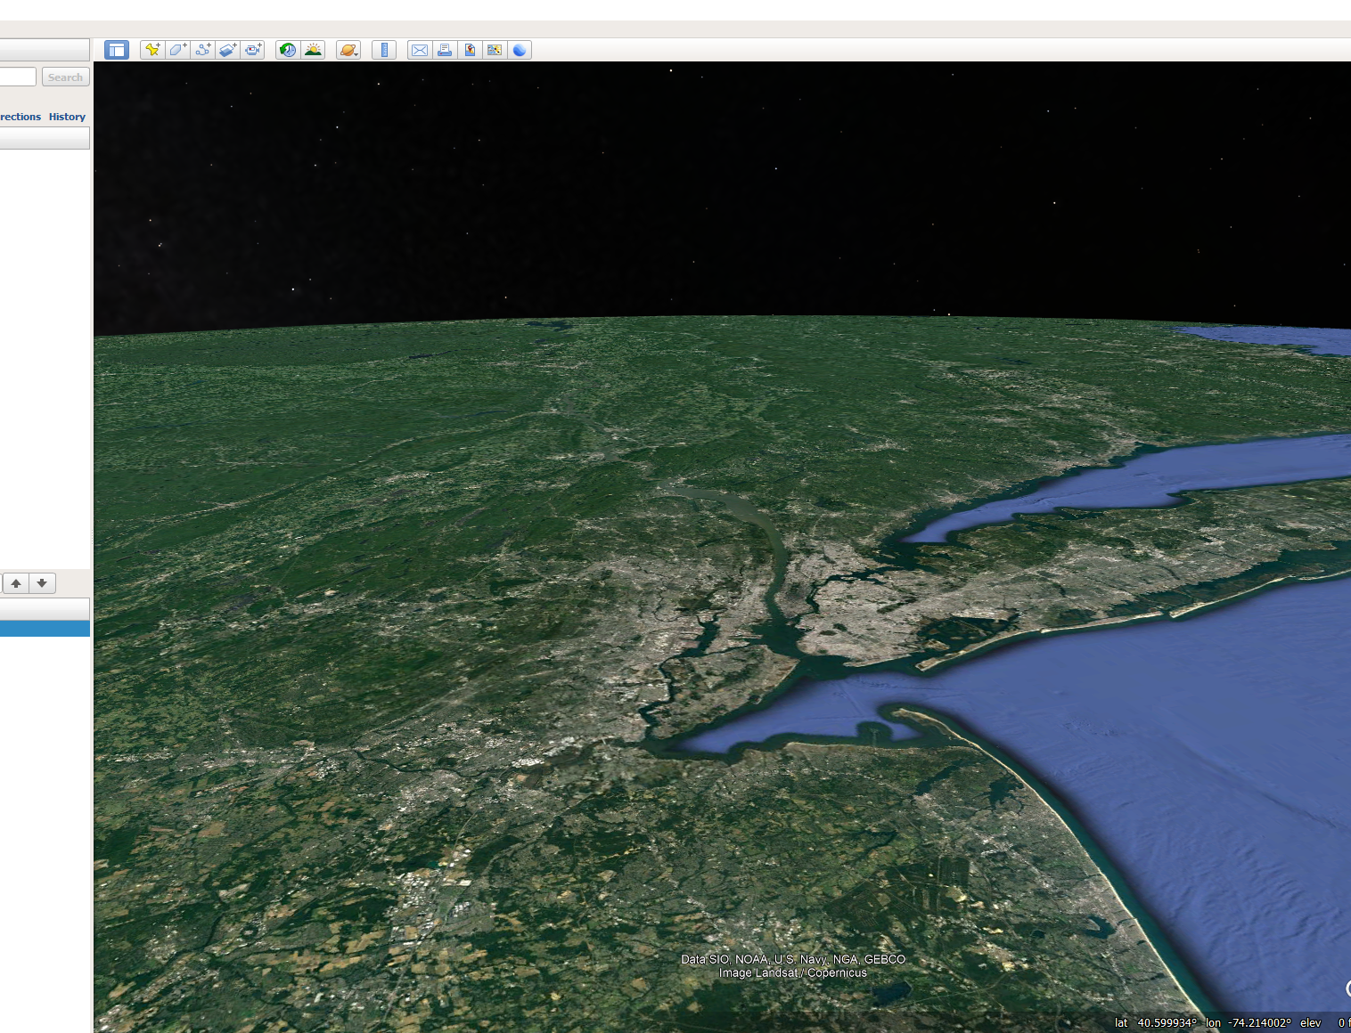


Slide 34
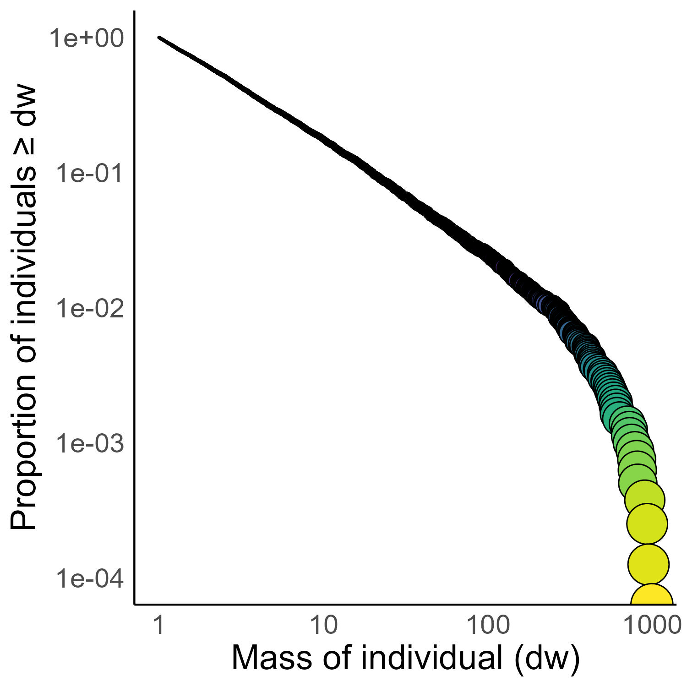
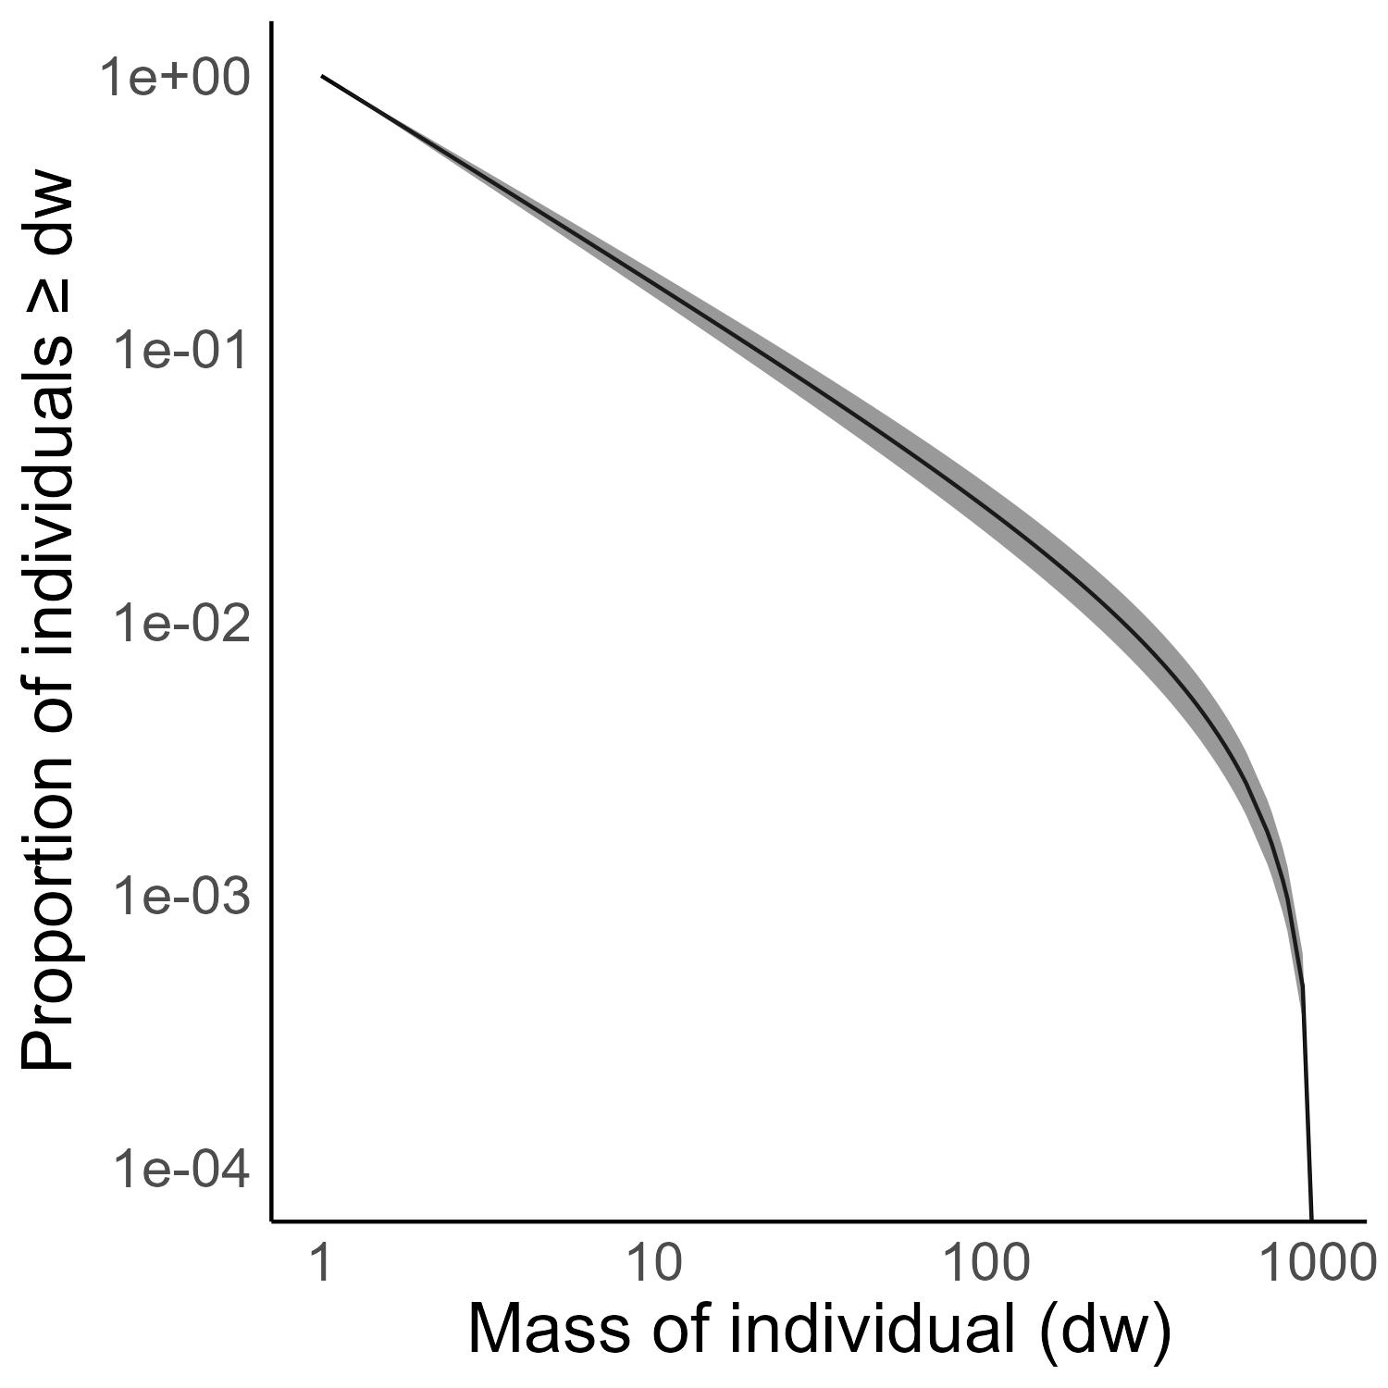
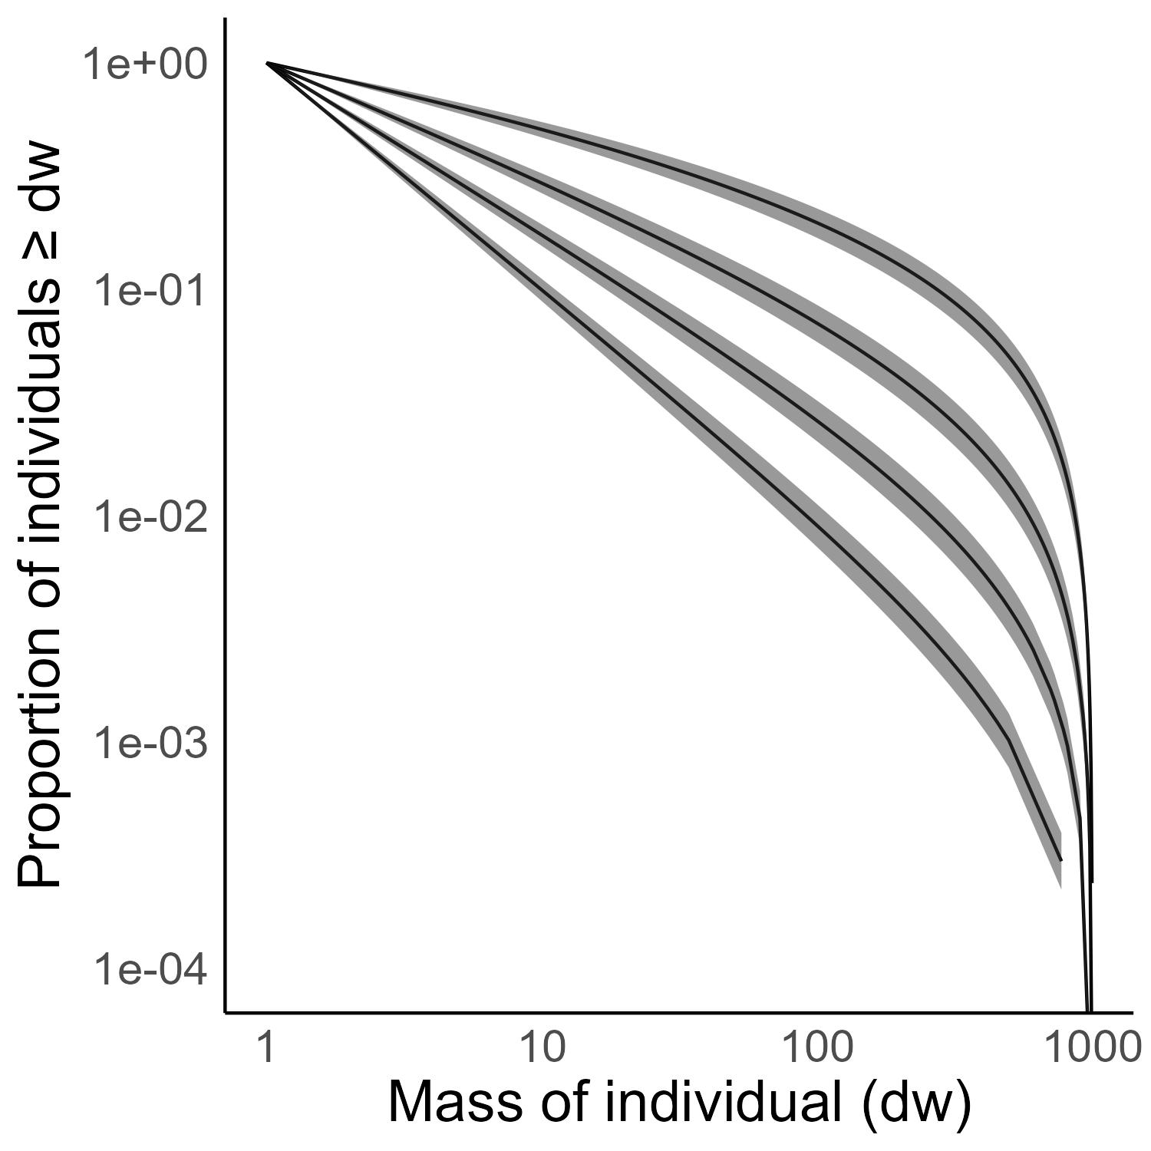
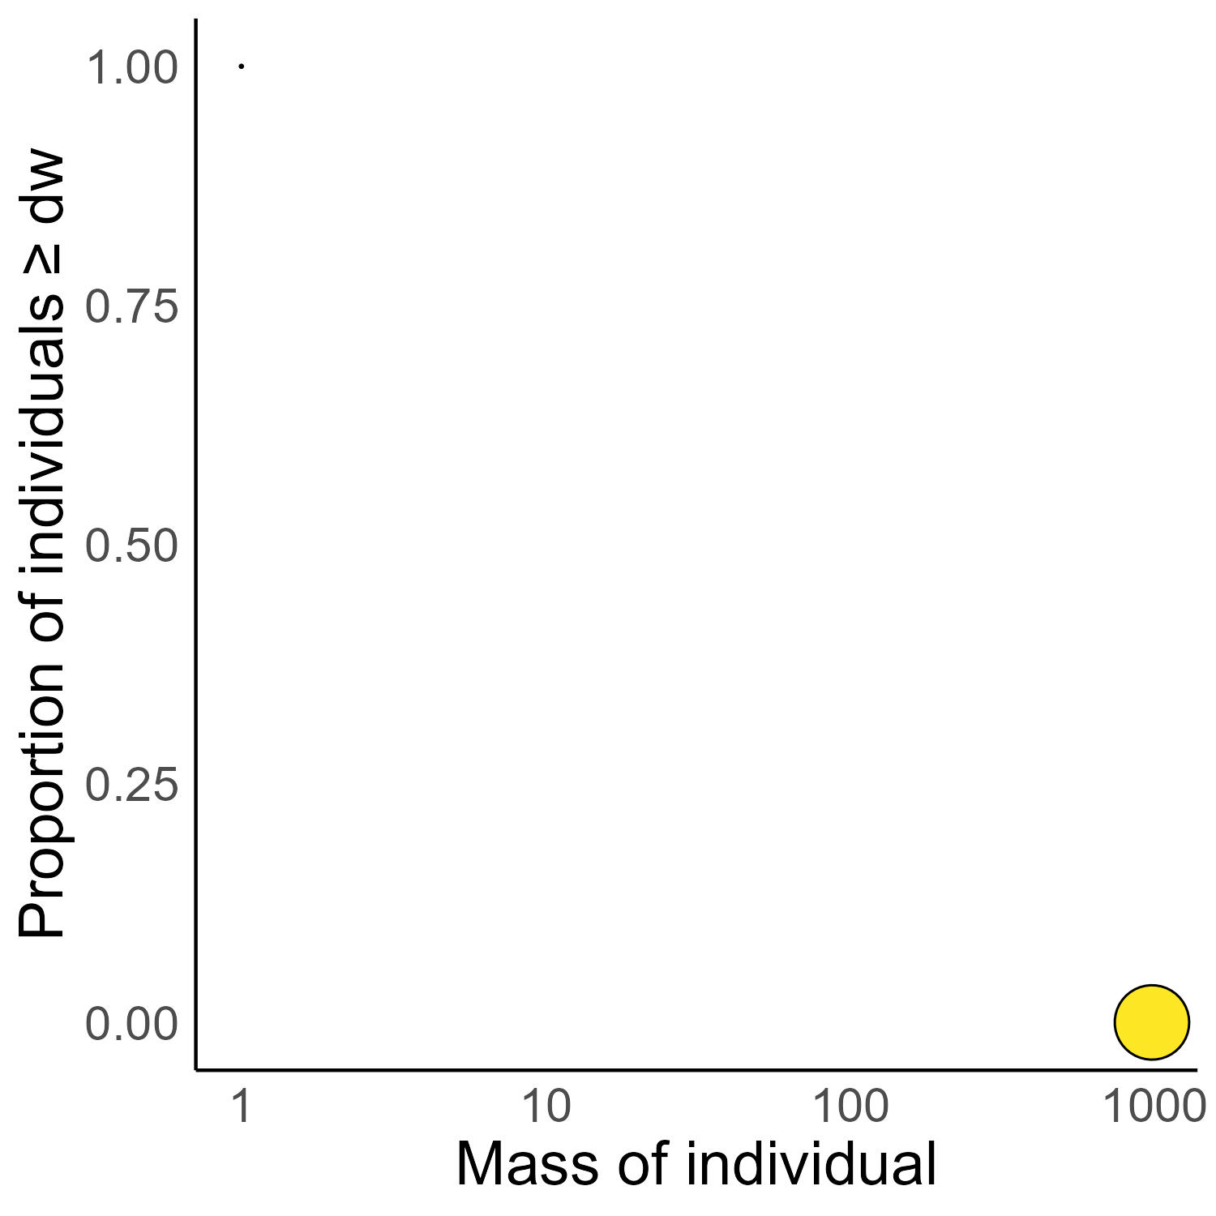
Individual Size Distribution
λ = -1.75
λ = -1.25
ISD – relative frequency of individual sizes in an ecosystem
How does it vary among sites?
λ = -1.55
λ = -1.75
λ = -2

Slide 35
Does temperature change the ISD?
Temperature (Yvon-Durocher et al. 2011;
Saito et al. 2021; Pomeranz et al. 2022)
λ = -1.75
λ = -1.25
Temperature should “steepen” the ISD
But sometimes it “flattens” the ISD
Or has no effect (Mazurkiewicz et al. 2020)
Possibly due to resource supply
λ = -1.55
Temperature
(O’Gorman et al. 2017)
λ = -1.75
λ = -2
Resource Supply
(O’Gorman et al. 2017)

Slide 36
Weak linear increase in standing biomass. Moderated by resource supply.

Slide 37
Predictions
Steeper ISD’s
Less biomass
Yvon-Durocher et al. 2011
Saito et al. 2021
Pomeranz et al. 2022
Yvon-Durocher et al. 2011
Saito et al. 2021
Standing Biomass

Slide 38
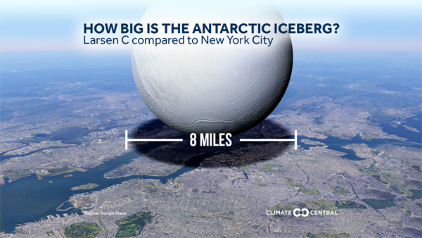

Slide 39
Eltonian pyramid of numbers ----> Individual Size Distribution
Size correlates with trophic level
Harder to support large organisms
Elhacham, E., et al. (2020). Nature, 588(7838), 442-444.
Bar-On, Y. M., et al. (2018. Proceedings of the National Academy of Sciences, 115(25), 6506-6511.

Slide 40
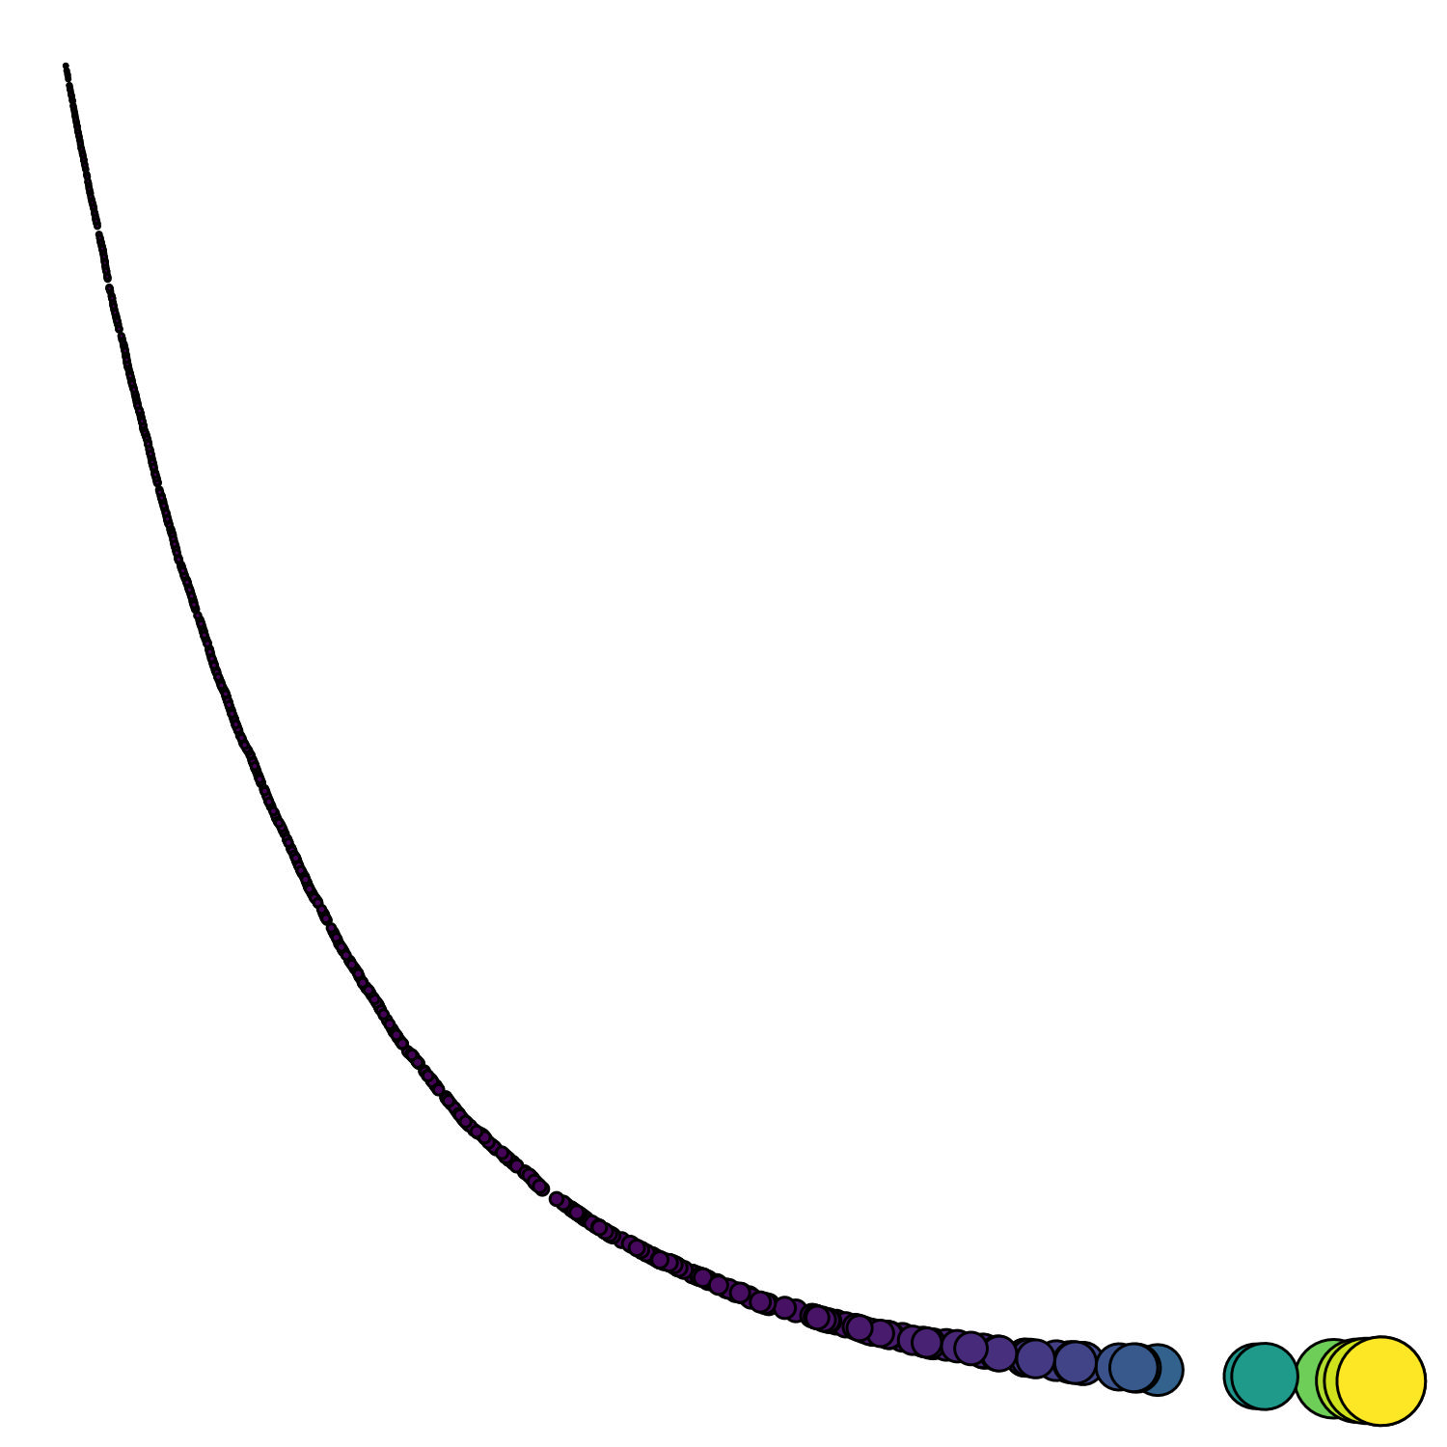
Individual Size Distribution
ISD – relative frequency of individual sizes in an ecosystem
Ataxic
Power law
Trophic transfer efficiency
Proxy for ecosystem function

Slide 41
Individual Size Distribution
ISD – relative frequency of individual sizes in an ecosystem
Ataxic
Power law
Trophic transfer efficiency
Proxy for ecosystem function

Slide 42
Individual Size Distribution
λ = -1.75
ISD – relative frequency of individual sizes in an ecosystem
Ataxic
Power law
Trophic transfer efficiency
Proxy for ecosystem function

Slide 43
1.1 trillion tons of living mass on earth
1 nonillion individuals
Large individuals are more rare than small individuals
Elhacham, E., et al. (2020). Nature, 588(7838), 442-444.
Bar-On, Y. M., et al. (2018). Proceedings of the National Academy of Sciences, 115(25), 6506-6511.
https://www.visualcapitalist.com/all-the-biomass-of-earth-in-one-graphic/

Slide 44
1.1 trillion tons of living mass on earth
1 nonillion individuals
Elhacham, E., et al. (2020). Nature, 588(7838), 442-444.
Bar-On, Y. M., et al. (2018). Proceedings of the National Academy of Sciences, 115(25), 6506-6511.
https://www.visualcapitalist.com/all-the-biomass-of-earth-in-one-graphic/

Slide 45
1.1 trillion tons of living mass on earth
1 nonillion individuals
Large individuals are more rare than small individuals
Elhacham, E., et al. (2020). Nature, 588(7838), 442-444.
Bar-On, Y. M., et al. (2018). Proceedings of the National Academy of Sciences, 115(25), 6506-6511.
https://www.visualcapitalist.com/all-the-biomass-of-earth-in-one-graphic/

Slide 46
Junker, J. R., Cross, W. F., Benstead, J. P., Huryn, A. D., Hood, J. M., Nelson, D., ... & Ólafsson, J. S. (2020). R esource supply governs the apparent temperature dependence of animal production in stream ecosystems. Ecology Letters, 23(12), 1809-1819.
Cross, W. F., Hood, J. M., Benstead, J. P., Huryn, A. D., & Nelson, D. (2015). Interactions between temperature and nutrients across levels of ecological organization. Global Change Biology, 21(3), 1025-1040.
Notes:
In particular, these food webs can be represented by ecological size spectra shown here, in which…

